Slide 1
Modern Frontend Tools
Adrian Błasiak

Slide 2
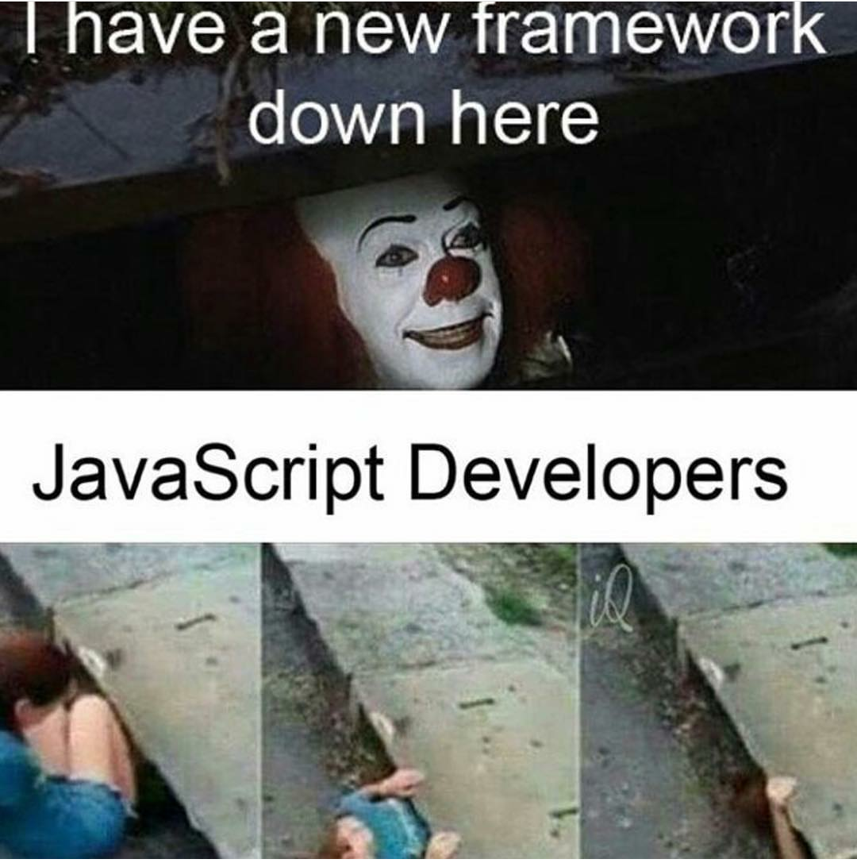
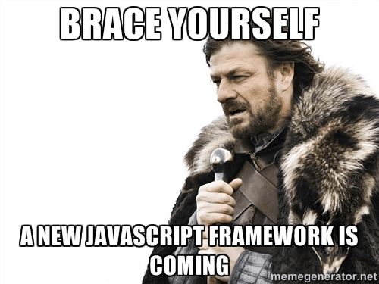
MOTIVATION

Slide 3
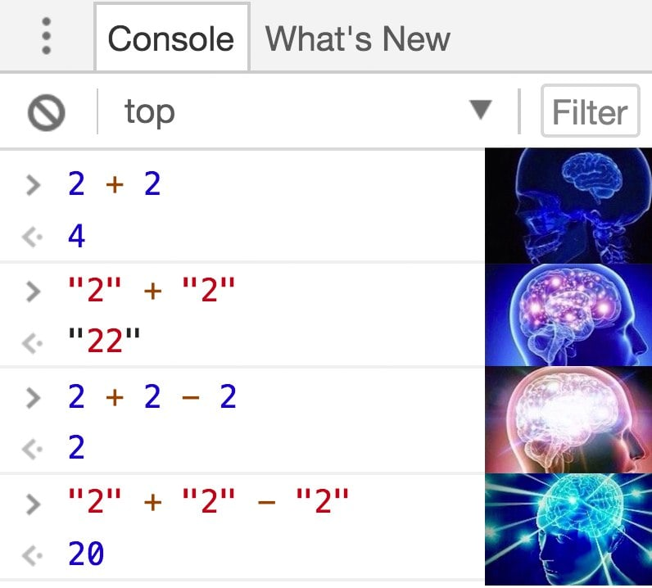
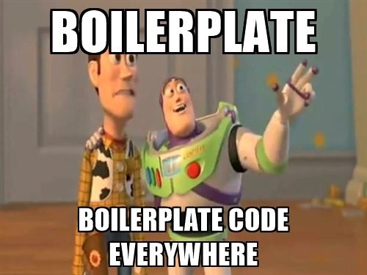
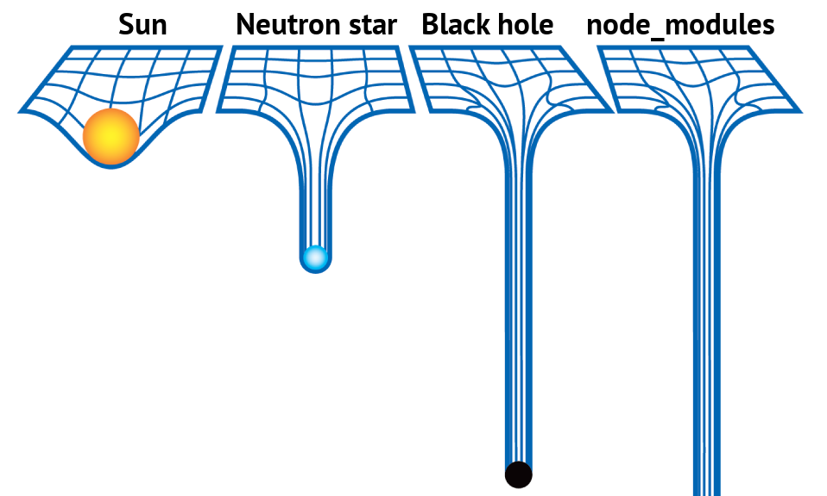
MOTIVATION ONCE AGAIN…

Slide 4


REAL MOTIVATION
The main purpose by doing this presentation is to inspire others how to obtain benefits of using some „frontend” tools.
Second is to propagate knownledge about modern frontend.

Slide 5
TOUR
Chapter 1
Modern module bundlers – easly
maintainable code
Time to answer up to 7 questions regarding 1 chapter
Chapter 2
How front-end tests can save your
time and make you confident
BONUS :-)
THE END – time to answer some question about all chapters

Slide 6
Modern module bundlers – easly maintainable code.

Slide 7
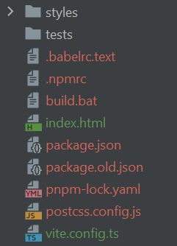
Problems WITH LEGACY FRONT CODEBASE
CHAOS in directory STRUCTURE and combining modules requireS
Additional steps from application, task runner side
Limited separation in directory structure. We can mix up some file types with unused trash. In addition
We must do some additional steps to handle some file type imports even if we can install another library it is not elegant at all.

Slide 8
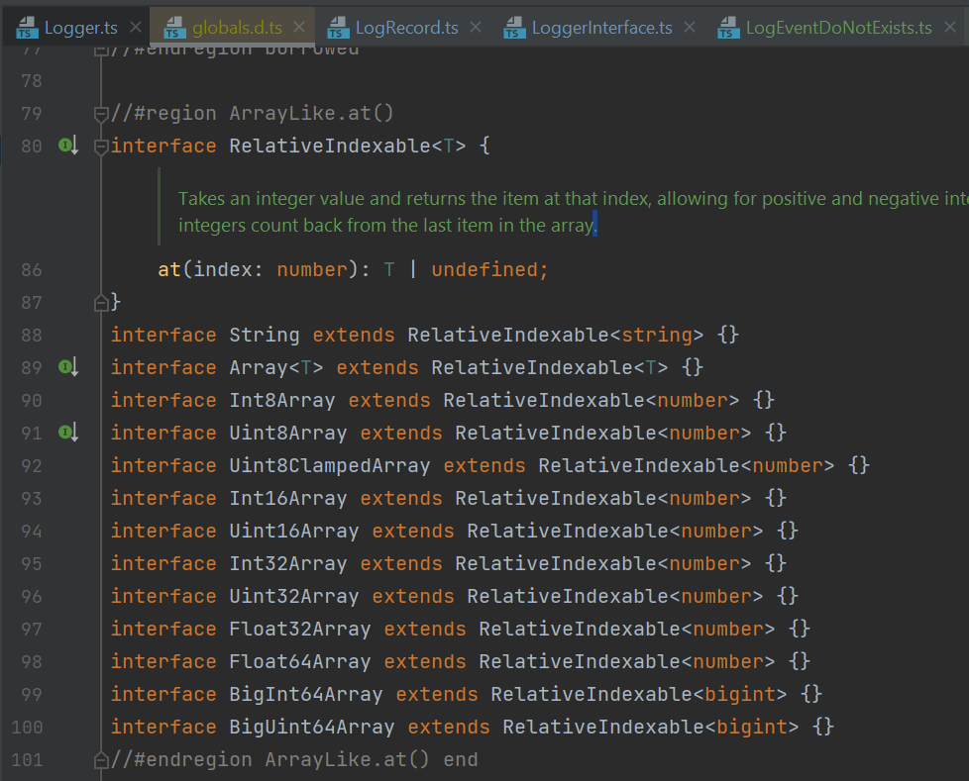
Problems WITH LEGACY FRONT CODEBASE
Limited possibility to store some metadata
Storing some comments, doctypes and other things must affect to code readability. Your files is also more huge and sensitive informations from code can be exposed.

Slide 9

Problems WITH LEGACY FRONT CODEBASE
Your cODE cannot be tested In unit/Integration front level SO must be tested in E2e or manually
You can try to test it using es6, umd modules but it has some limits in big picture.

Slide 10

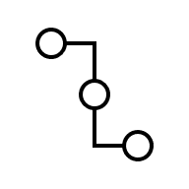

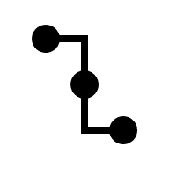
Problems WITH LEGACY FRONT CODEBASE
HarD to reuse some logic
Sometimes is not possible to predict how some future will change in application.

Slide 11


Problems WITH LEGACY FRONT CODEBASE
Problem with compatiblity
Some newer features may be unsupported by node or even by older browsers.

Slide 12


Problems WITH LEGACY FRONT CODEBASE
HARD to UPDATE DEPEDENCIES
Because you must invest more time to determine static files locations, version of deps and do some manually checks/research.

Slide 13
Problems WITH LEGACY FRONT CODEBASE
Mess in backend view templates
Because sometimes you need to pass some parameters or activate functionality in libraries in next scripts.

Slide 14
module bundler can solve some or all eventually discussed problems
Definition of module bundler
Module bundler – developer tool, which can build dependencies tree to merge all used modules as output file/s. These modules are includes source scripts and also third party dependencies.

Slide 15



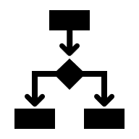
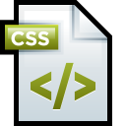

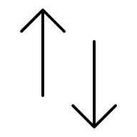




Module bundler described in visual way
AS proccess
Source files
Module bundler
Output – destination files
Entrypoint
Loader/s
index.js
Dependency tree
resolver
bundle.js
Middleware
(Transpilers,
Transformers)
submodule.js
style.css
Third party dependcies
Bundle builder
Libraries, Framework
Bundle Finalizer
Process and copy
Static resources
Static resources

Slide 16
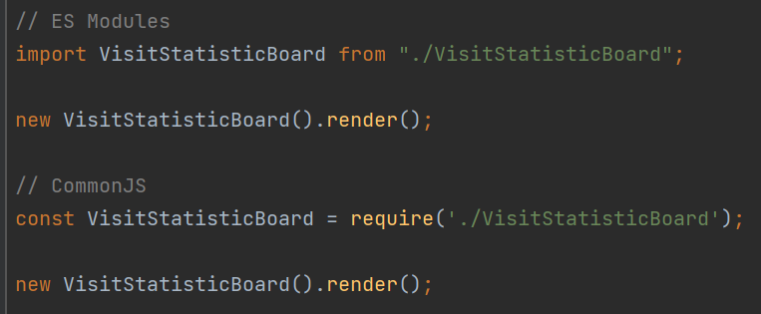
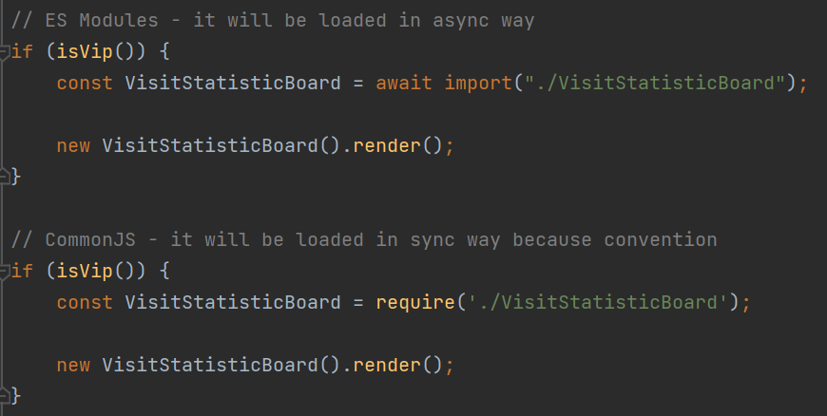
module bundler can solve some or all eventually discussed problems
What can do module bundler in general?
Combine all modules into one or more, in minified and optionally obfuscated dist file/s.
Resolve dependencies tree.
Generate source map to debug easier in webbrowser.
Exclude some content like metadata ex typescript types, unused code and comments.
Prebuild assets like images, structured data.
Lazy load some modules as external prepared scripts.
Regular import – combining module as pieces
Lazy import – called also code splitting

Slide 17









fact #1 - History of project bundling
Support for
transpilers
JS-bundlers era
Rust-bundlers era
Module
builds
REQUIRE.JS
2011
Vite
WEBPACK
Percel
Timeline
Rollup
2019
Browserify.js
Snowpack
2009
2012
2015
2017
2021
Loading
Modules
with action
only
Auto-detection
index.html modules
Turbopack
esbuild

Slide 18
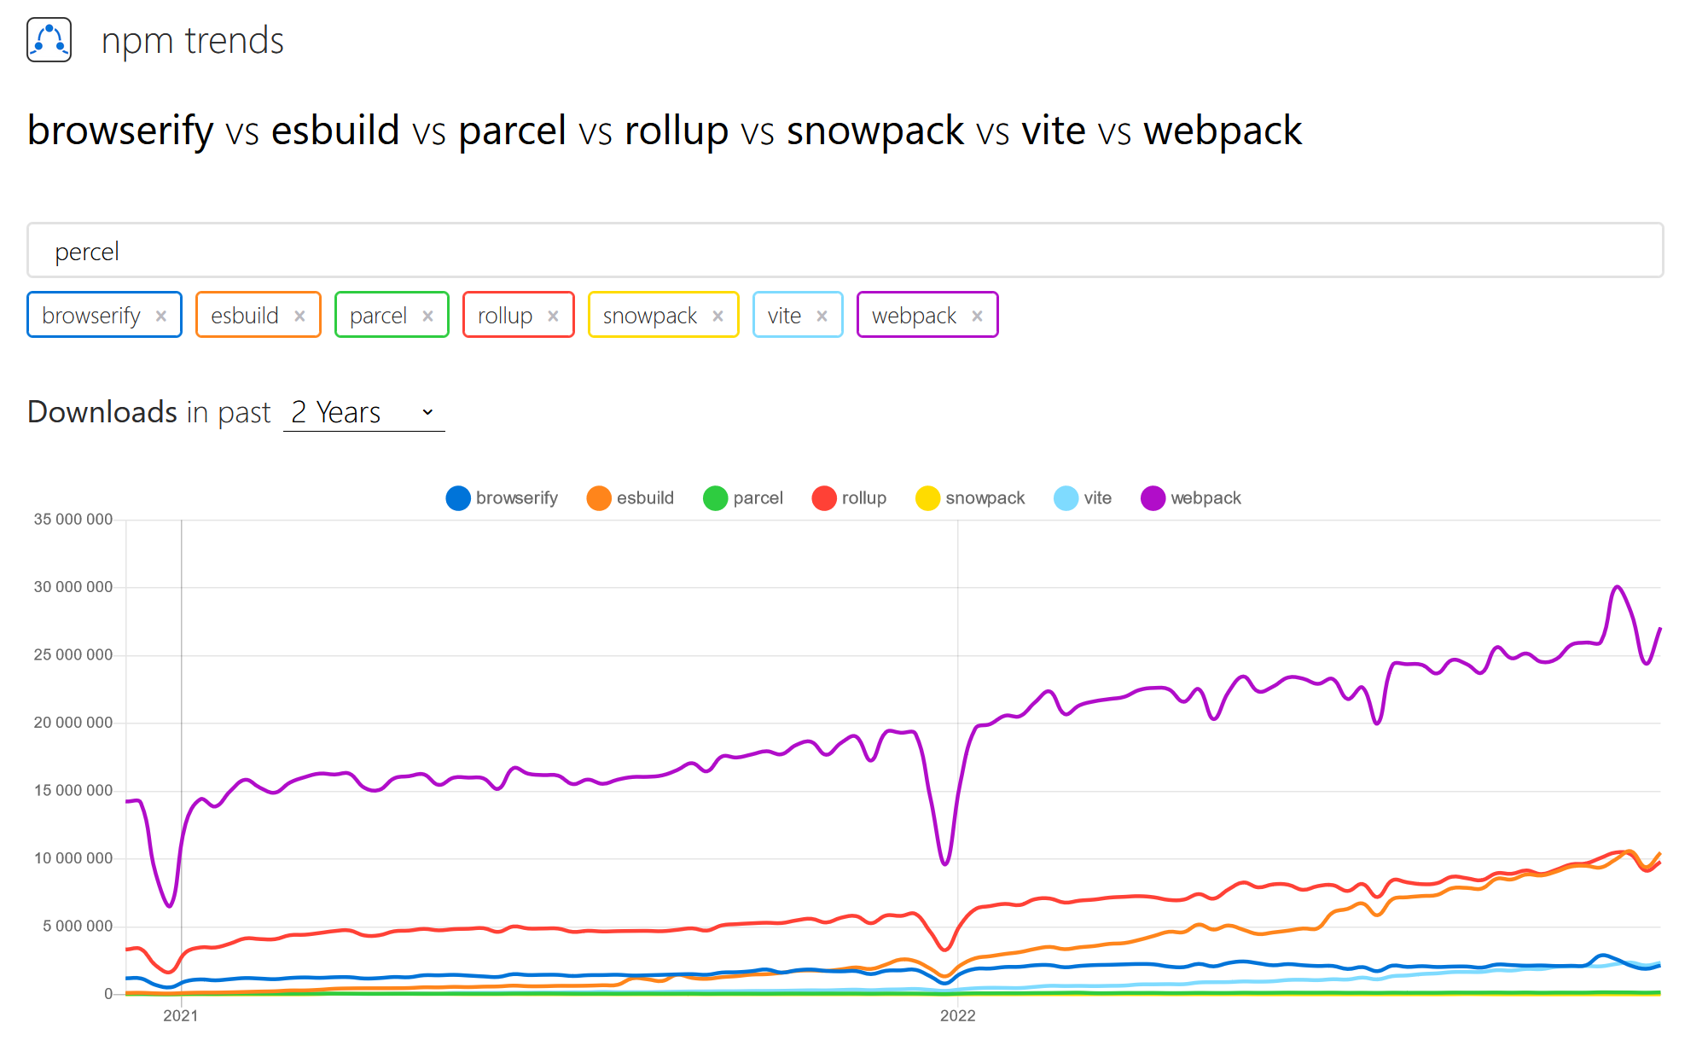
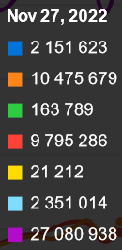
B
U N D L E R S P O
P
U
L
A
R
I
T
Y

Slide 19

MODERN MODULE BUNDLERS
Most interesting module bundlers for now are Webpack most as stable and most popular selection and Vite for rapid bundling, which is still growing.
Major module bundler features:
Three-shaking
HMR (Hot Module Reload/Replacement)
Dev-server with in-memory changes.

Slide 20

MODERN MODULE BOUNDLERS – WHY VITE?
Vite is much faster than webpack and grows really fast with great community support. Also documentation is user-friendly and configuration for now is quite advanced, because it also uses rollup.
Other benfits:
Huge ecosystem around vite
Possibility to use all new modern frontend technologies
Support for prebundling, glob imports and pre-compiled webasm.
Fast start with new project just by using one command.

Slide 21
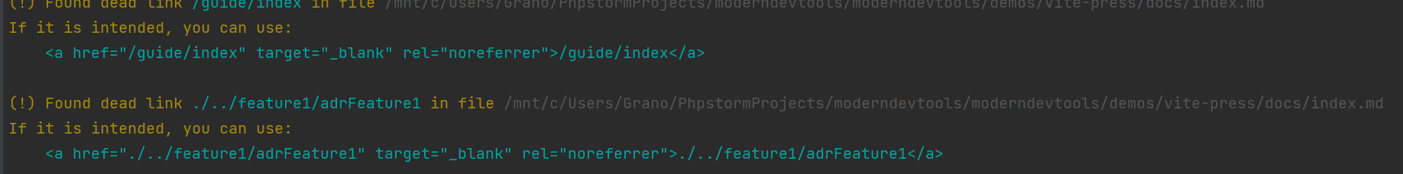
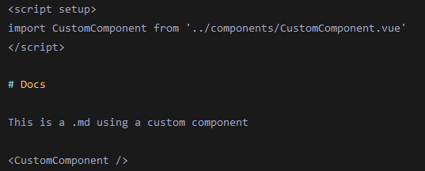
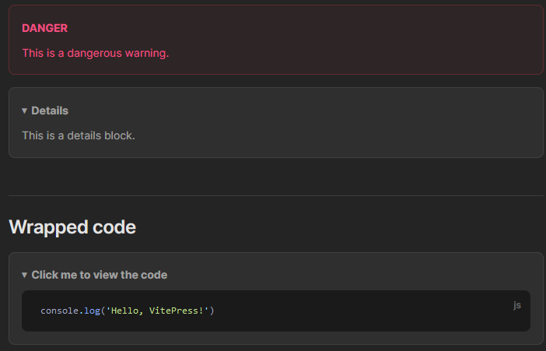
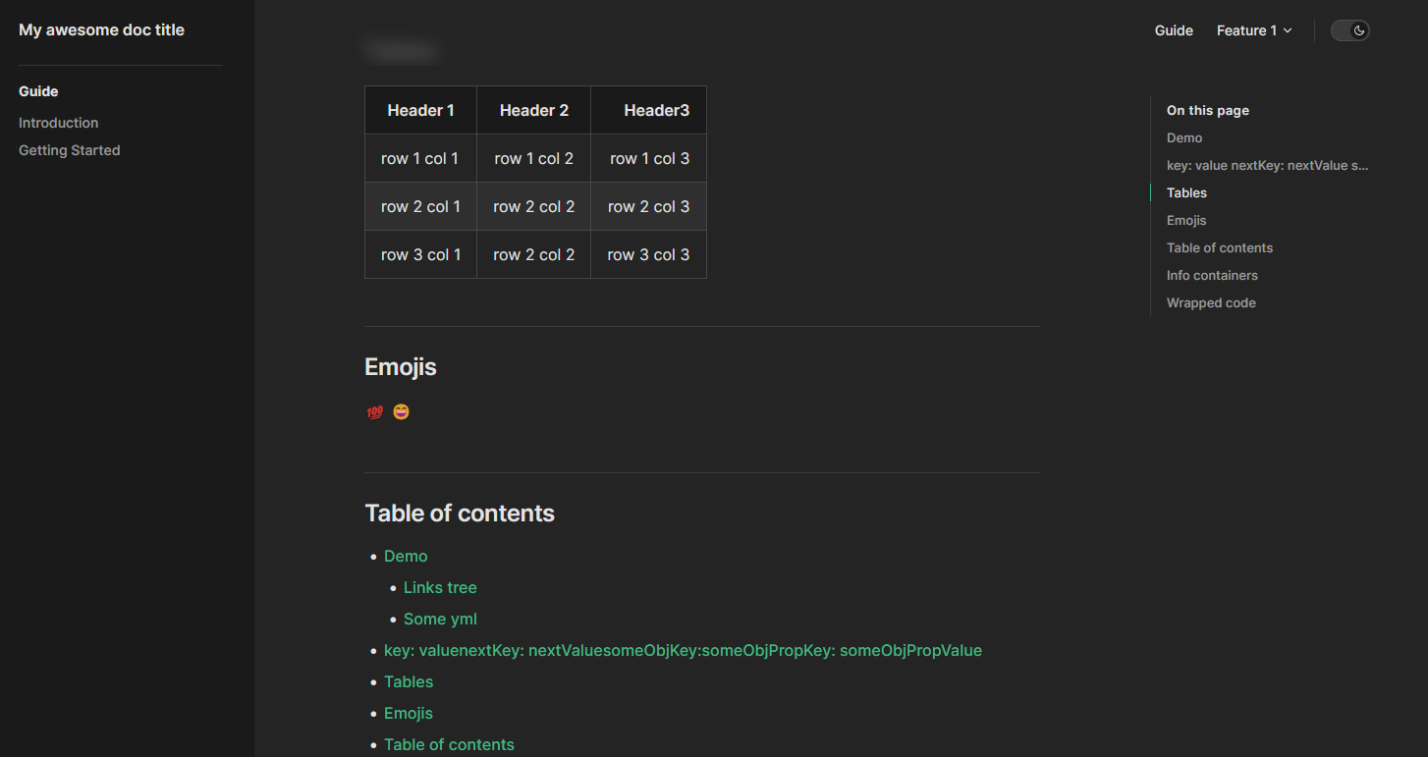

MODERN MODULE BOUNDLERS – VITE RELaTED PROJECTS
Dead link detection feature
Vitepress:
Create beatiful documentation in markdowns.
We can also extend vitepress with awesome themes and
Functionality and use them in configuration.
Vitetest:
Run tests easly in parrarel, preview results faster, code coverage and benchmarks reports, type testing and more! Great toolbox for testing in frontend.

Slide 22
MODERN MODULE BOUNDLERS – WHY WEBPACk?
Webpack is stabilized technology with the largest plugins and presets base. We also can define each loader which makes webpack highly customizable.
Other benfits:
Compatibility with almost all JS libs
Webpack handles circular dependencies well.
Advanced configuration is easier to achieve.

Slide 23

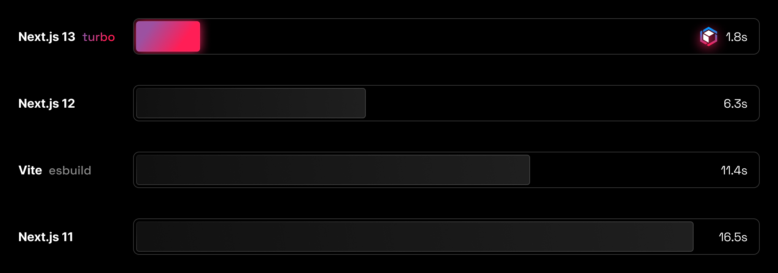
MODERN MODULE BOUNDLERS – WHY turbopack?
I do not recommend switching to turbopack for now, but it can be choosen because of speed for now only. I added it only as a funfact.
You can try performance tests by yourself using cargo instruments profiler.
Read more:
Profiling – Turbopack

Slide 24
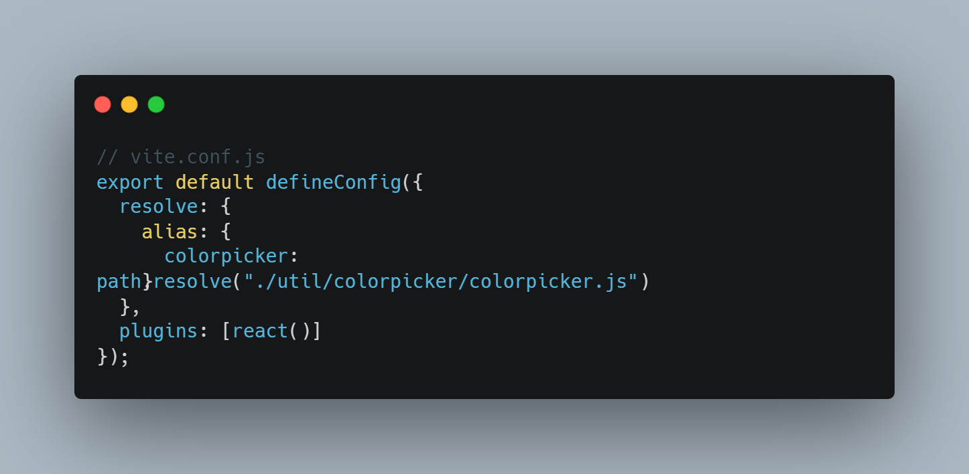
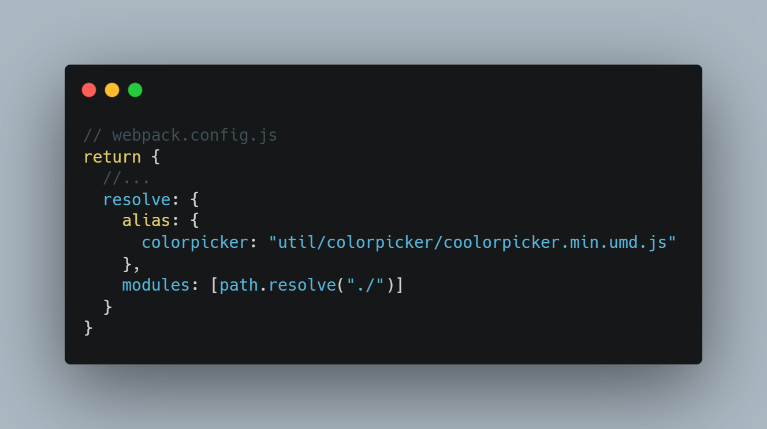
MODERN MODULE BOUNDLERS – WEBPACK AND VITE
Use case: Aliases can be usefull when your project
has complex directories structure.

Slide 25
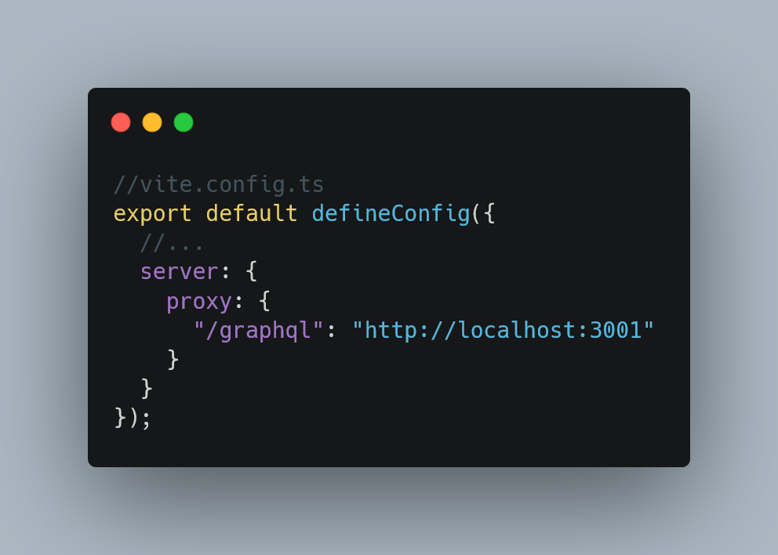
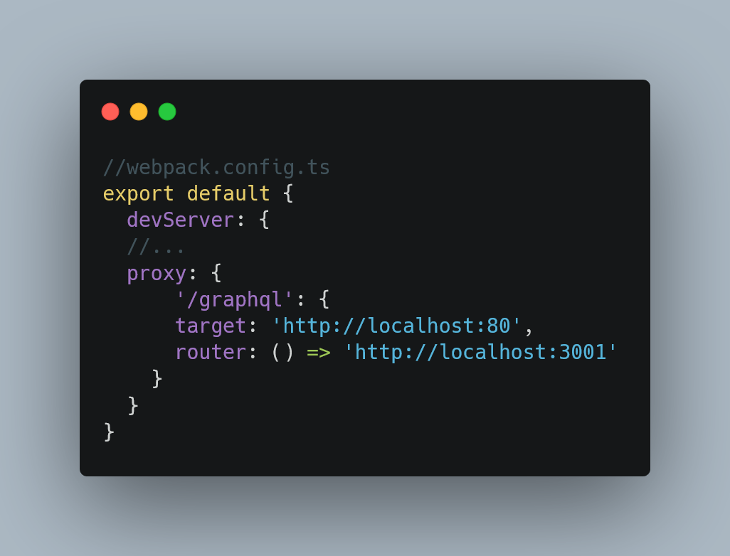
MODERN MODULE BOUNDLERS – WEBPACK AND VITE
Use case: Bind your external service with endpoint and query params.

Slide 26
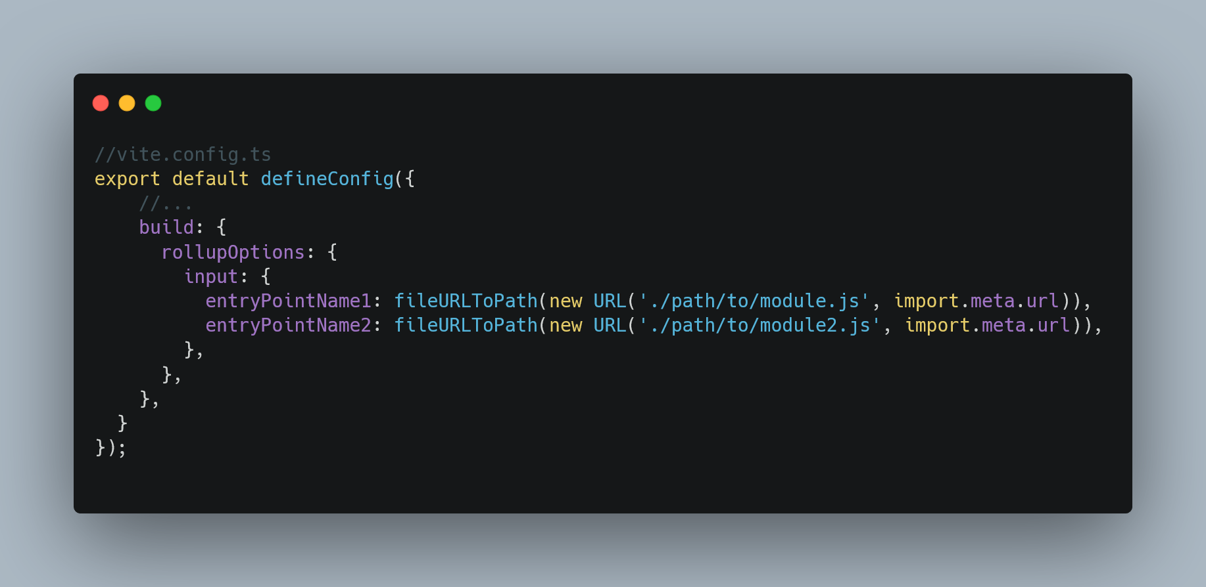
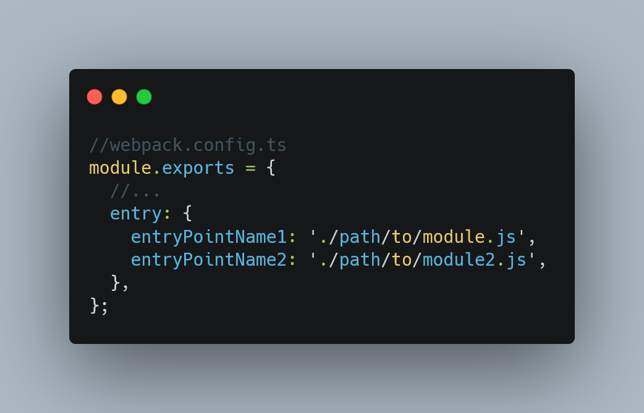
MODERN MODULE BOUNDLERS – WEBPACK AND VITE
Use case: Sometimes you need to define multiple file
for big libraries with various submodules.

Slide 27
MODERN MODULE BOUNDLERS – WEBPACK AND VITE integration
Symfony Webpack Encore (Webpack)
Laravel Mix (Webpack)
Laravel Assets (Vite)
Symfony recommends using webpack

Slide 28
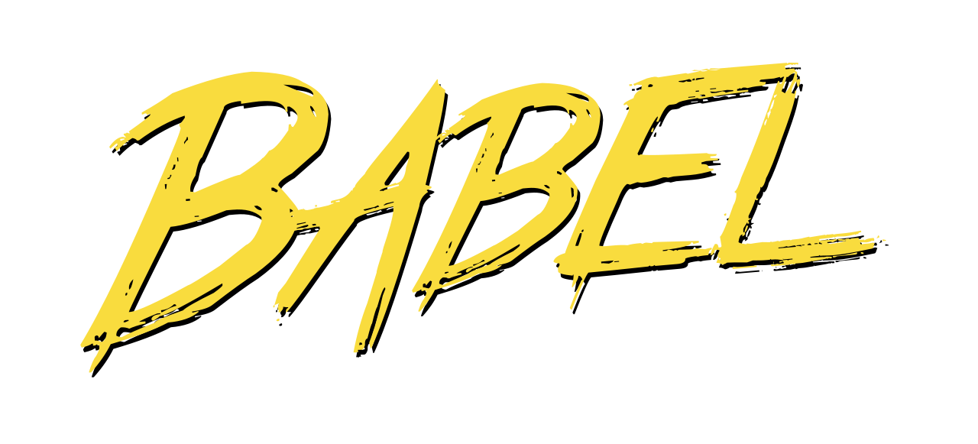
fact #2 - BABEL
You propably recognise this name as tower of babel, its kinda reference because babel is a module loader which can be used for instance in webpack to transpile and transform code. Transformation can be especially useful when we need to substitute new features into old piece of code.

Slide 29



MODERN MODULE BOUNDLERS –DEMO
Compare and describe bundlers.
Show storybook
Using transformers to ensure code compatiblity.

Slide 30
How front-end tests can save your time and make you confident

Slide 31


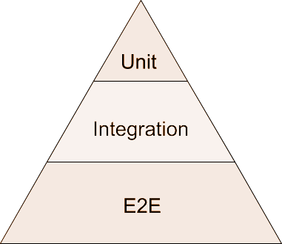
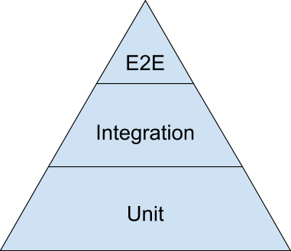
Problems WITH LACK OF TESTS ON FRONEND
Your cODE have many E2e TESTS, which are much slower Than lower level
Your code contains many slow e2e tests because you need to test some crucial UI parts
Of application. Some aspects we cannot test in e2e tests.

Slide 32
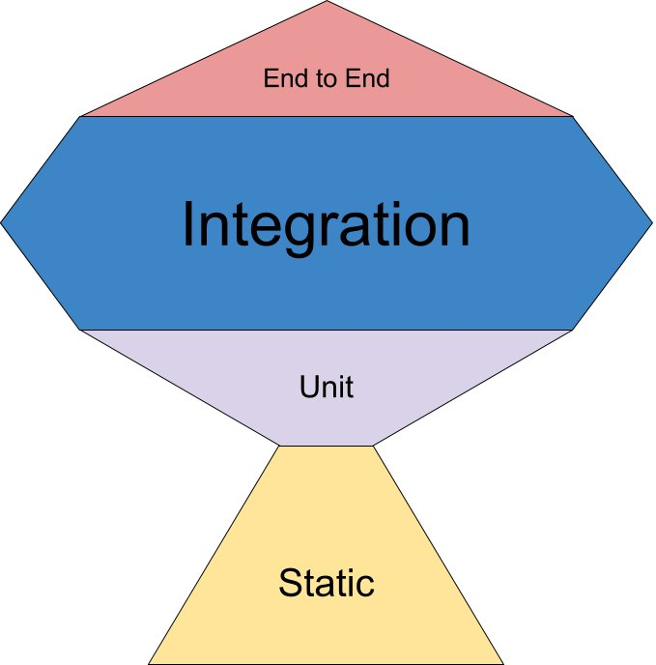
Problems WITH LACK OF TESTS ON FRONEND
Lets look again at the testing levels
.. But to be more precise, frontend pyramid looks more like this:
The Testing Trophy – Kent. C. Dodds

Slide 33

Problems WITH LACK OF TESTS ON FRONEND
HARDER TO DETECT SOME UNEXPECTED BEHAVIOUR
Sometimes in your system can exist some bug, which is undetectable from usage perspective but can affect with addtional server consuption. Just imagine additional event listeners resposible for user action.

Slide 34
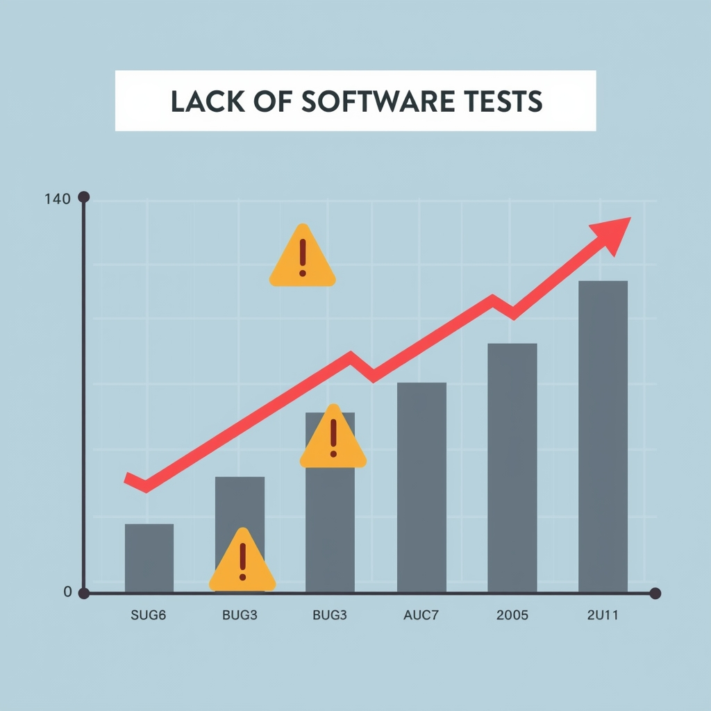
Problems WITH LACK OF TESTS ON FRONEND
Hard to apply some changes and detect regression
Without proper amount and quality of any test levels we can miss some issues after upgrade. Also integrating some untested modules can be exacting.

Slide 35

Problems WITH LACK OF TESTS ON FRONEND
HARDER TO DEBUG JAVASCRIPT STUFF
When you use webdriver, debugging and logging complex actions is limited or even impossible.

Slide 36

DISCLAIMER
Only good quality tests can give some value, so for instance when you have a simple element to render without state, only which is designed to display something it should be not tested because it can be cosidered as testing framework/library itself. Assuming this sometimes is not worth to write tests.
Remember about creating your test aids to have less code in the test logic and more pretty interface to setup your env and write cool assertions ☺

Slide 37



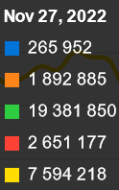
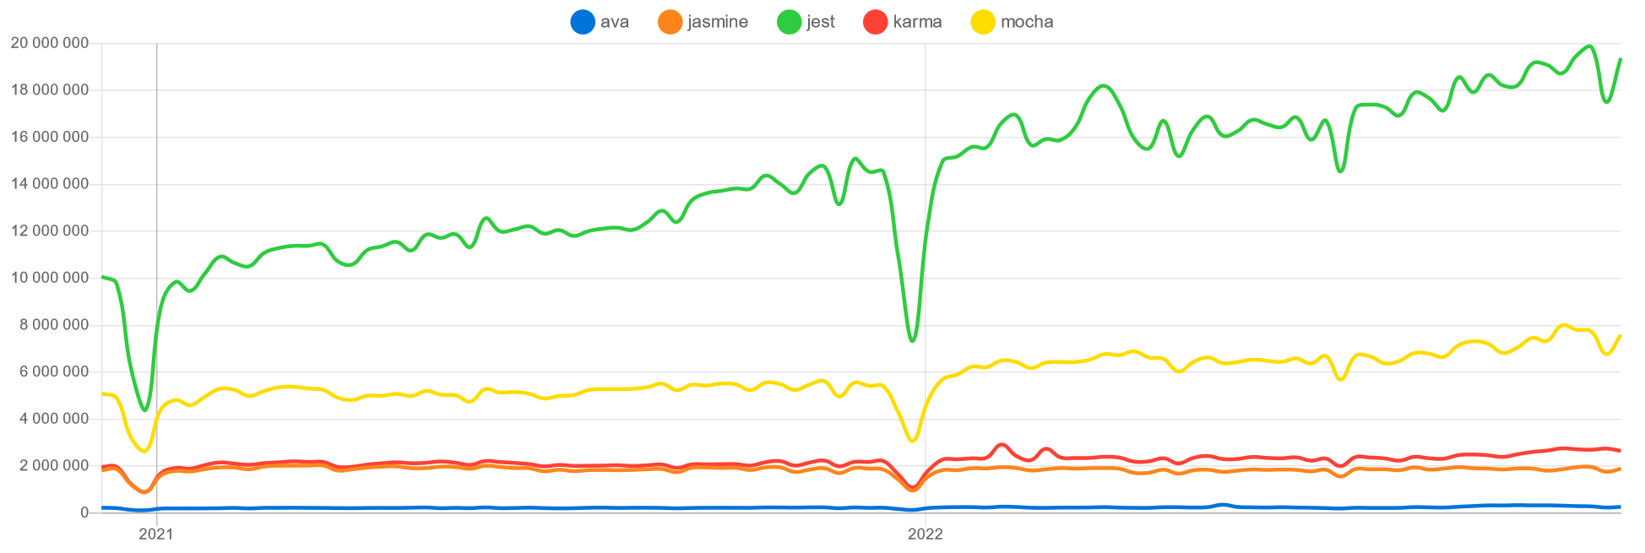
FRONT-END unit tests
Unit tests CODE TOOLS
Jest
MochaJS
Jasmine - BDD
Ava
Vitetest

Slide 38
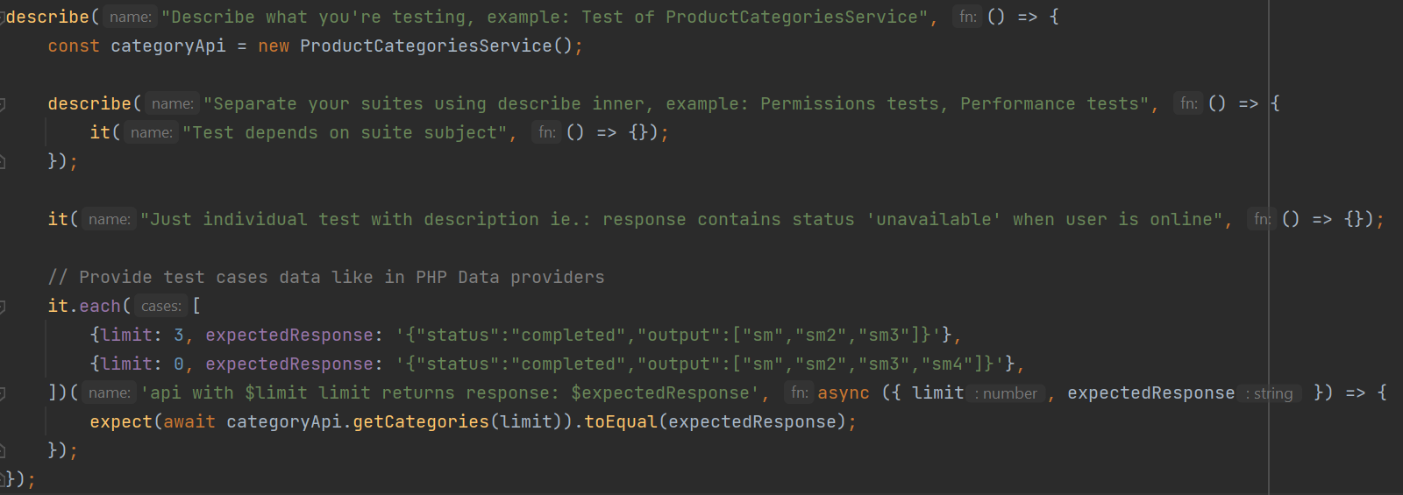
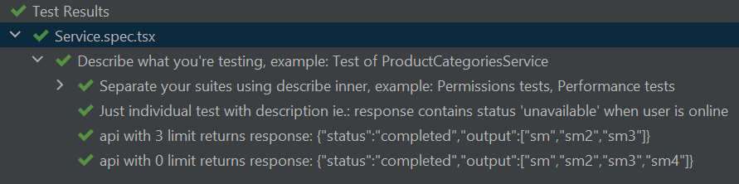
FRTONEND UNIT TESTS – BASICS
How unit tests works in front – bolerplate structure
Descriptions are visible in cli output and in phpstorm also :-)

Slide 39



UNIT TESTS – SNAPSHOOTS
SNAPSHOOT TESTING
Snapshoot testing is quite useful when we need to detect some UI changes between version. Default snapshoot is created after first time running some test with snapshoot matcher invoked. This apporach is called artifact-based testing.
Basically we will use text
Snapshoots in most cases
If you want to update snapshoot, use command:
jest --updateSnapshot
But we can also use:
signatures
images
hash

Slide 40
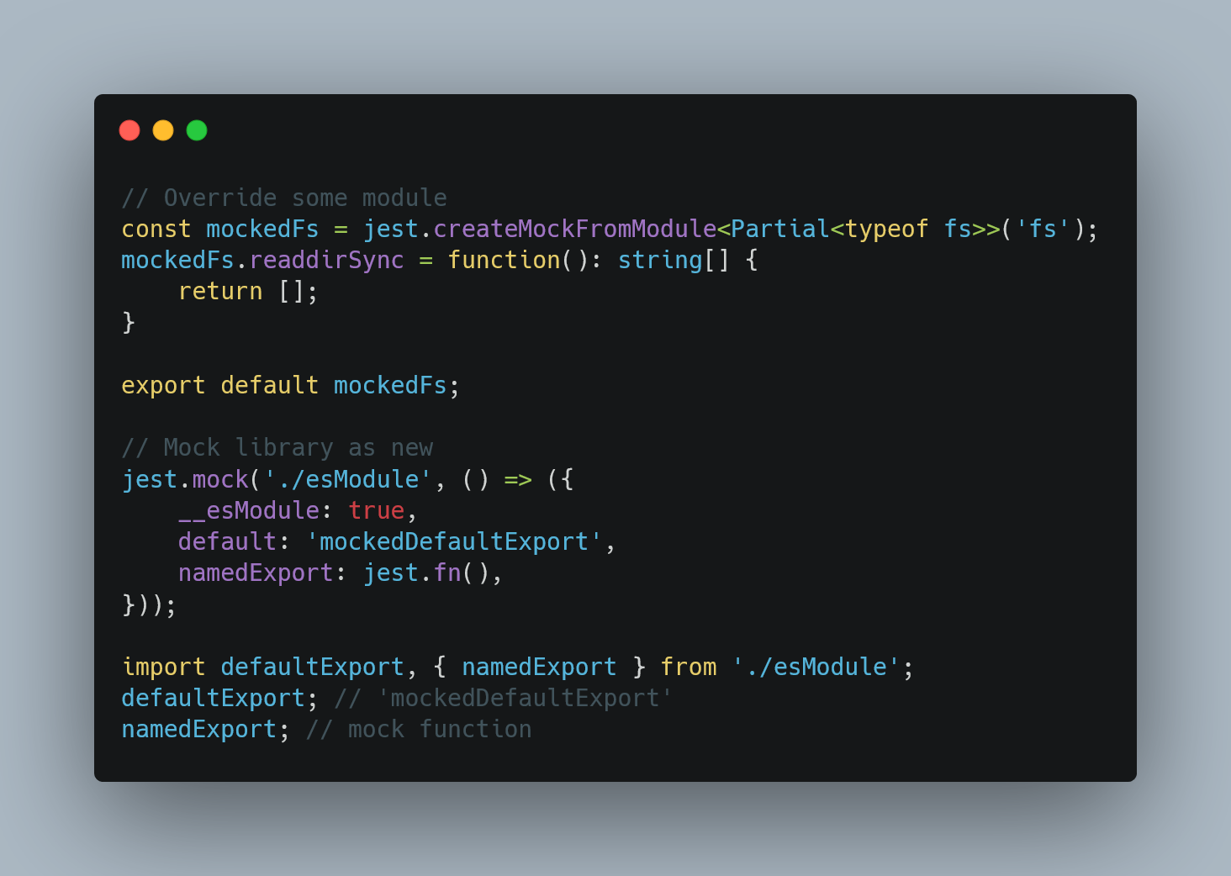
UNIT TESTS – MOCKING
MOCKIng BASE FUNCTIONALITY
We can mock in Jest our targets in many ways. Most popular are: mocking global accessors, mocking system datetime, mocking hooks and other things.
MOCKIng APIS
Apis should be mocked by using some static data variant, we have many llibraries to achive this and also some ways. The first one is just mock fetch api. Second is to use some connection handlers and finally mocked server.
MOCKIng libraries
We can also mock some module in library or all library, when we really need it. Every mock can be reset after each test if we want it.

Slide 41



FRONT-END e2e tests
WHY to use front-end e2e tests with codeception (PHP) tests?
We can detect more details with async workflow. We have devtools protocol and many tools to do some work faster in browser cause’ these tools are built-in browser.
Integration anD e2e tests CODE TOOLS
Playwright
Cypress
Codeception.js

Slide 42
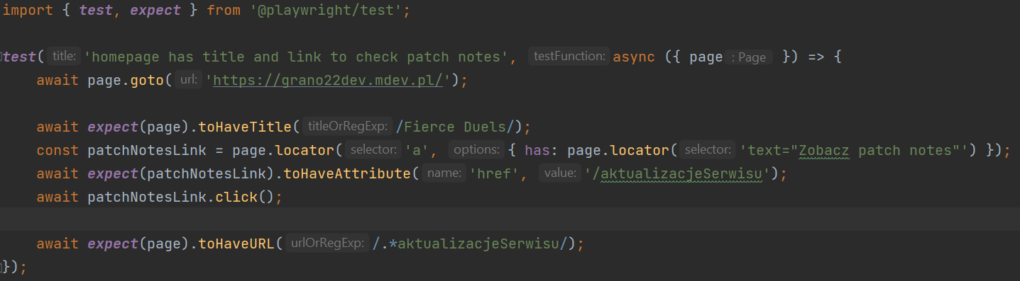
FRONT-END e2e testing in general
EXAMPLE WITH playwright
You can generate new test with command: npx playwright codegen --device="iPhone 11" site.net (for iphone)
This is pretty basic example, because more complex tests are better organised. But as
You can see it looks similar somehow to unit tests as a structure, but there’s some less
significant differences, apart from common async usage in many actions.

Slide 43
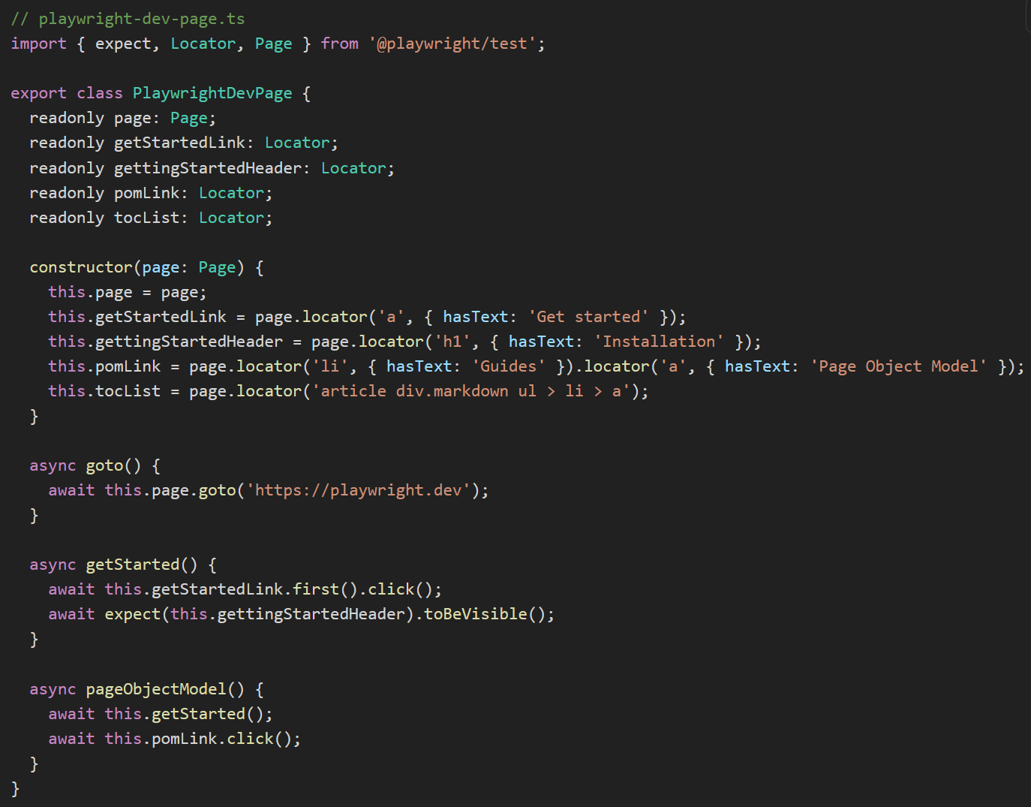
FRONT-END e2e testing – good practises
Page object model PATTERN (POM)
Use Page Object Models to reduce amount of code reproduction if you use same
page in many tests. Most of methods should represents action on page.

Slide 44
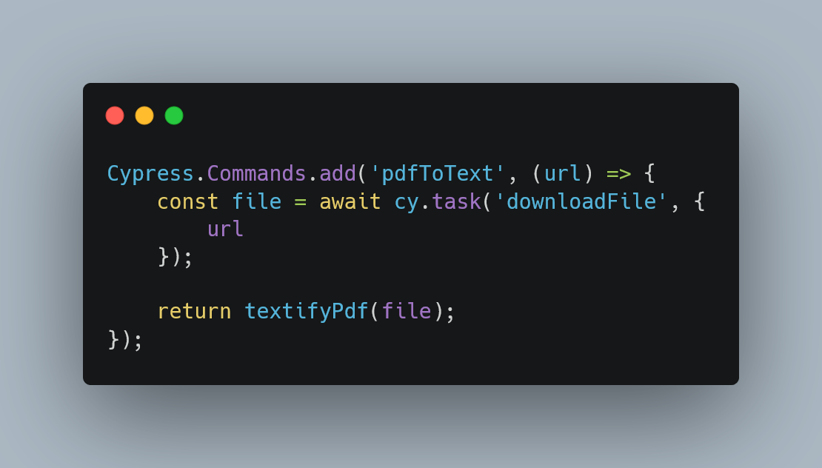
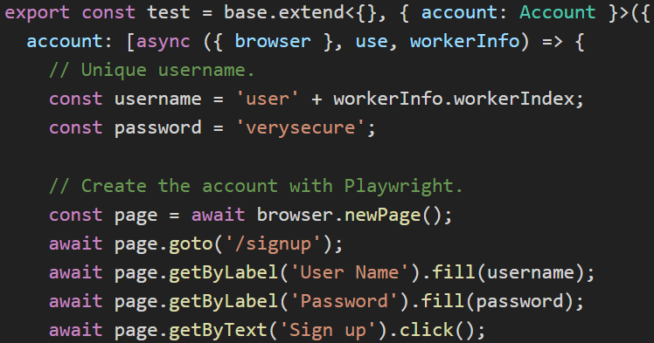
FRONT-END e2e testing – good practises
PAGE ACTIONS PATTERn
Page actions is like a more general solution to handle same/very similar situation in different
pages or at least one. Is more extensible than POM, when our page is less specific than others.
CYPRESS
PLAYWRIGHT
In cypress we can define custom command to
to handle check an animation for instance.
In playwirght we can create some worker
scoped fixture or functions to achieve this.
Afterwards it can we invoked like: cy.pdfToText

Slide 45
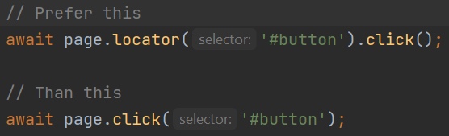
FRONT-END e2e testing – good practises
PASS locators over SELECTOR
Locators can prevent to exist some unoticed changes in element.

Slide 46
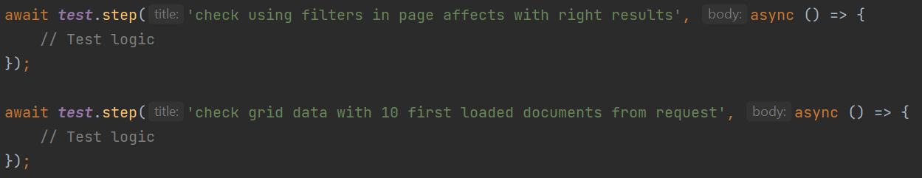
FRONT-END e2e testing – good practises
Try to split tests with steps using test.STEP
Readability of test is most of the important thing to keep clean because is easier to maintain
and to split some pieces of check logic when it will be needed.

Slide 47



FRONT-END TESTS - DEMO
Jest mocks
Show how react tests works
Show best of vitetest (in my opinion)

Slide 48
Summary – nice to remember
Module bundler is processing all imported/required modules by default, except from lazy imports to one bundle files by default. Lazy imports can be usefull especially when you need to load something external according condition.
Webpack can use babel as loader to transpile typescript, cofeescript and more javascript ast similar langs, is the most customizable loader at all. It also using transforms to make our destination code compatible with other browsers. For instance it can generate same but more code for optional chaining.
Frontend unit and integrations tests can help you handle having too many e2e tests and also bring more more data, better debugging and catching more researchable errors.
Use POM and Page Actions pattern to reduce code repeat and to make tests more readable. Also try to sepearate your tests steps and prepare good description.
Test visible user behaviour by visible handlers, use test-id(s) only when absolutely necessary, for instance in the legacy code that cannot be easily rewritten.

Slide 49
BONUS 1/2 - Some handy other tools
Capture code framgents into images – Carbon .
Collection of logos – icones.js .
Slides maker and presenter – sli.js .
Generating social media posts as images – poet.so and tweetlet .
Do pretty screenshoot of your API – API Flash .
Best i know editor to take notes in markdown – Obsidian .
All-in-one it tools with PWA – IT tools.

Slide 50
BONUS 2/2 – DEVTOOLS SLIDESHOW FROM MY LAST TALK
This presentation is about modern webbrowser devtools. You can learn from there about running snippet without extension, capturing screenshoots of page areas or recording your action in browser to replay.

Slide 51
END
Thanks for your attention

