Slide 1
DevTools in the Browser

Slide 2
Agenda
Introduction (~3mins)
Web devtools capabilities (~10 mins)
Console and debugging tricks (~10 mins)
CDP, WebDriver BIDI (~7 mins)
AI in the Browser (~7 mins)
* BONUS * communication between the puppeteer and the browser extension (~5 mins)
Q&A session (~3-10 mins)

Slide 3
Presentation disclaimers
Recording – cannot guarantee but I plan to keep the live recorded
Expectations – touch the surface, high level overview. No deep dive into tech details too much.
Q&A – Please, write a questions with Q: prefix
Presentation – will be shared on the linkedin after some time, PDF of summary is also planned but not guaranteed.
Source code of presented apps won’t be shared unless well prepared in future. I don’t plan it now.
Feedback – The survey results will be made available at the end.

Slide 4
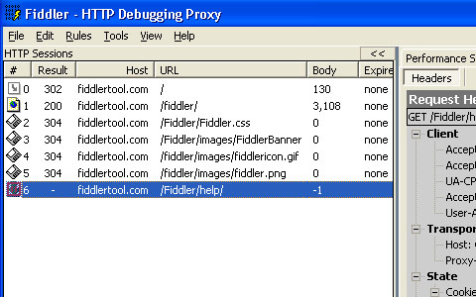
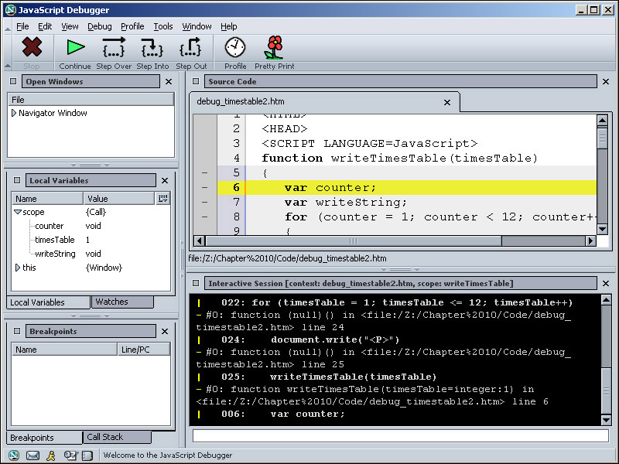
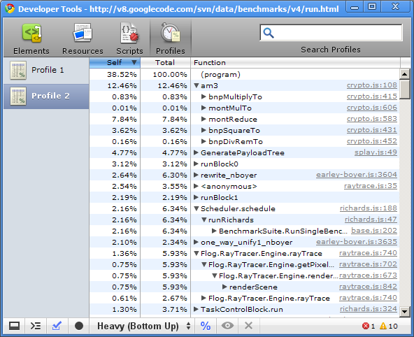
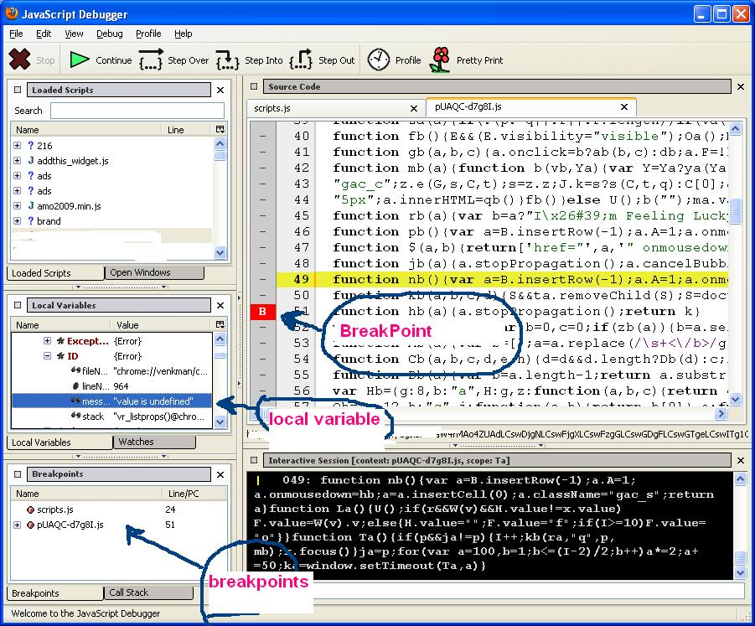
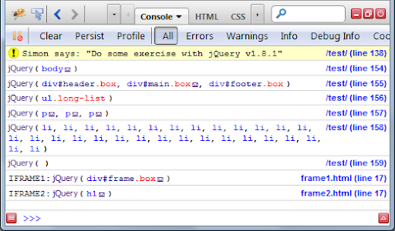
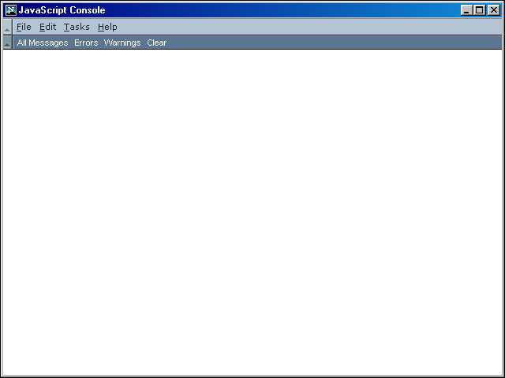
A little bit of history
Chrome DevTools
Venkman Debugger
Chrome 1.0 beta
2003,
HTTP proxy debugging tool
1997
2006
Netscape 4.x+
Netscape 7.x+
2001
2008
Netscape console
Firebug

Slide 5
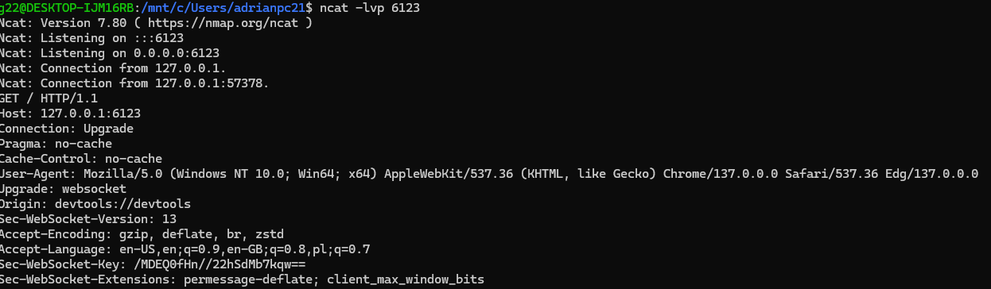
Before we begin, few facts
devtools://devtools/bundled/devtools_app.html?ws=127.0.0.1:6123&panel=console&inspected_test=https://example.com&debugFrontend=true
DevTools displayed in the browser panel are real HTML pages
You can explore them as regular webpage
Example in chrome (using URL): devtools://devtools/bundled/devtools_app.html.
In case of firefox- devtools.chrome.enabled is needed in about:config
about:devtools-toolbox, then you need to open console twice [ctrl + shift + alt + I]
You can interact with them
Linux – ncat –lvp wsTarget
Windows (PowerCat) – Connect-PowerCat –RemoteIp 127.0.0.1 –Port 8080
Windows (after downloading nmap) – ncat.exe –lvp wsTarget
If you want to debug via ws

Slide 6
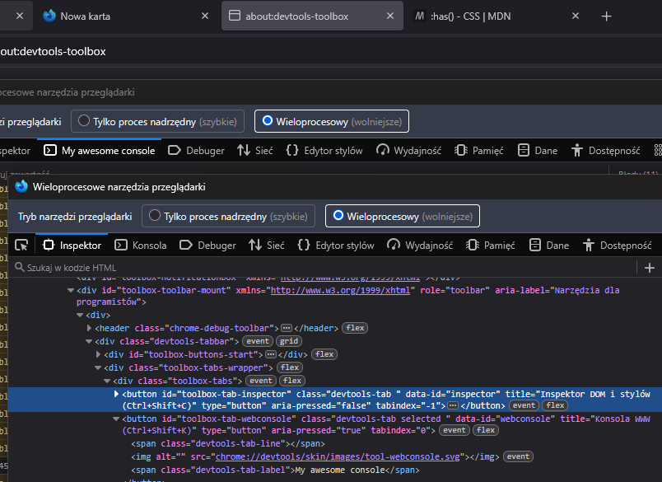
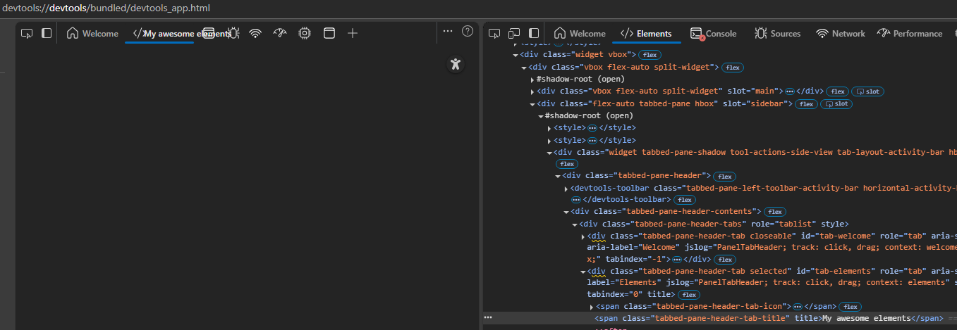
It’s looks like

Slide 7
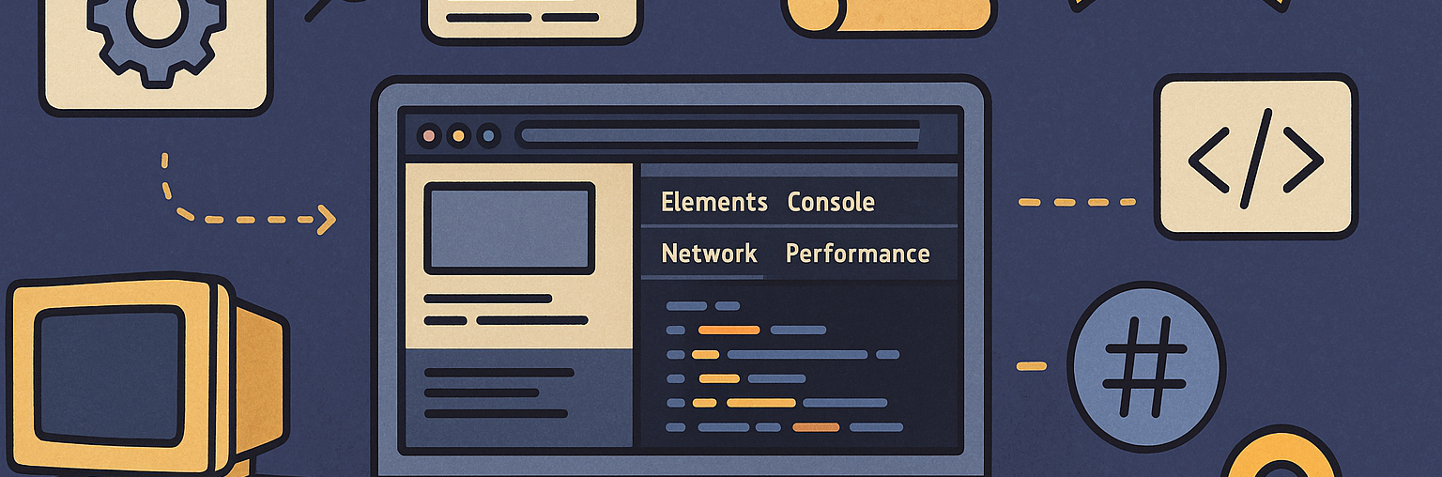
Web DevTools Capabilities
Most interesting from my perspective features available from the browser

Slide 8
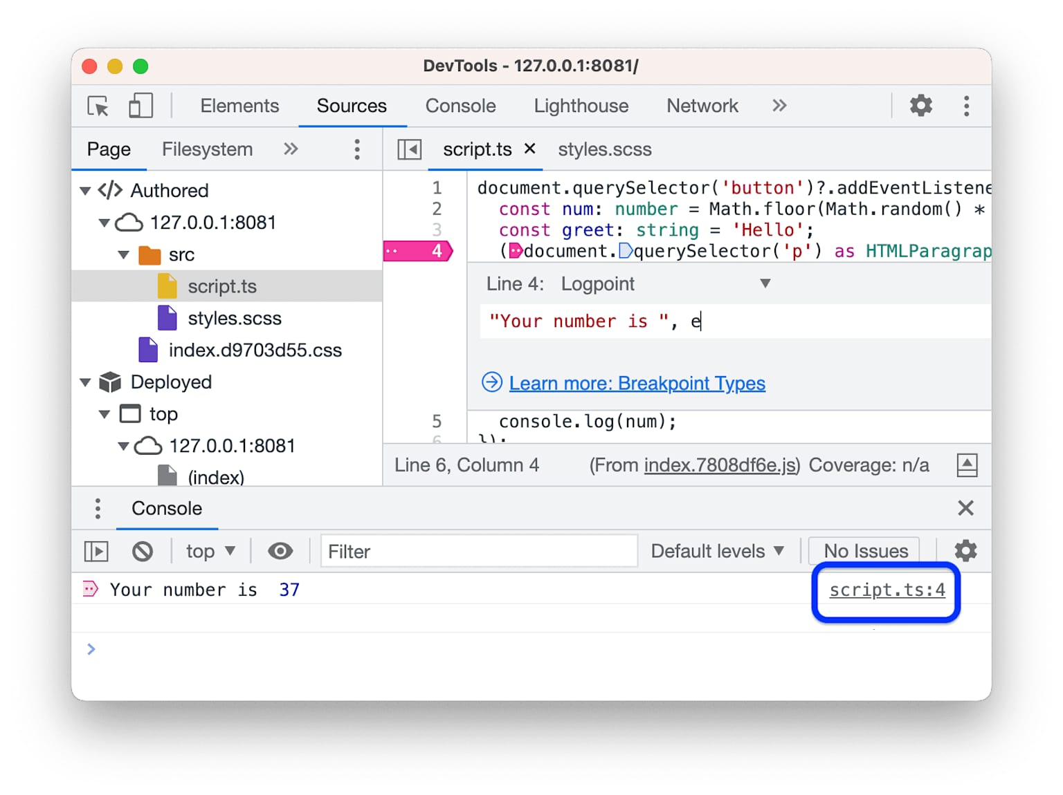
Features
Panels
Memory analysis with snapshots
Detached DOM elements
Networking
Throttling simulation
Mobile bridging
3D View – powerful to investigate stacking contexts, z-indexes
Accessibility analysis
CSP Analysis
and more…
Logpoints - https://developer.chrome.com/docs/devtools/javascript/source-maps

Slide 9
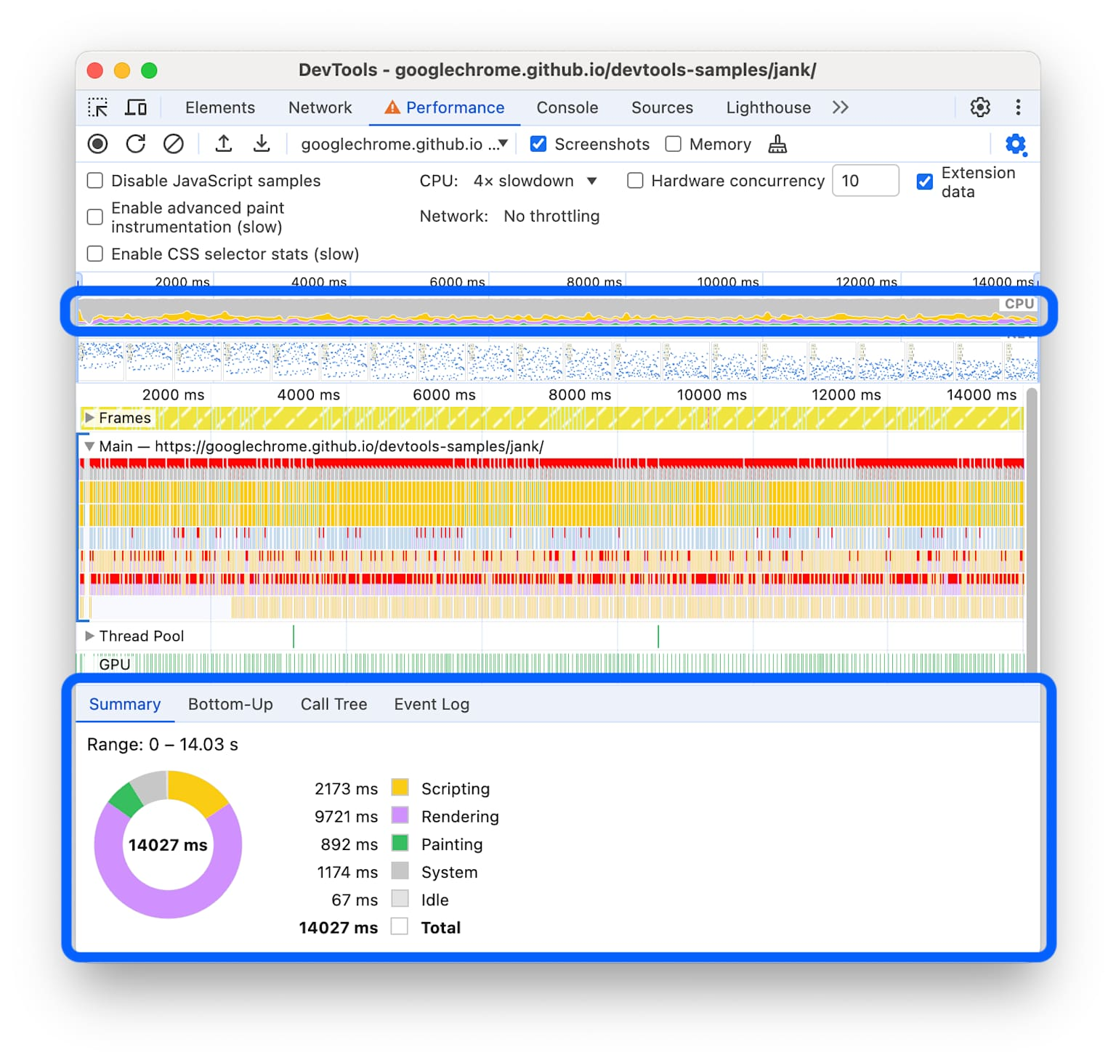
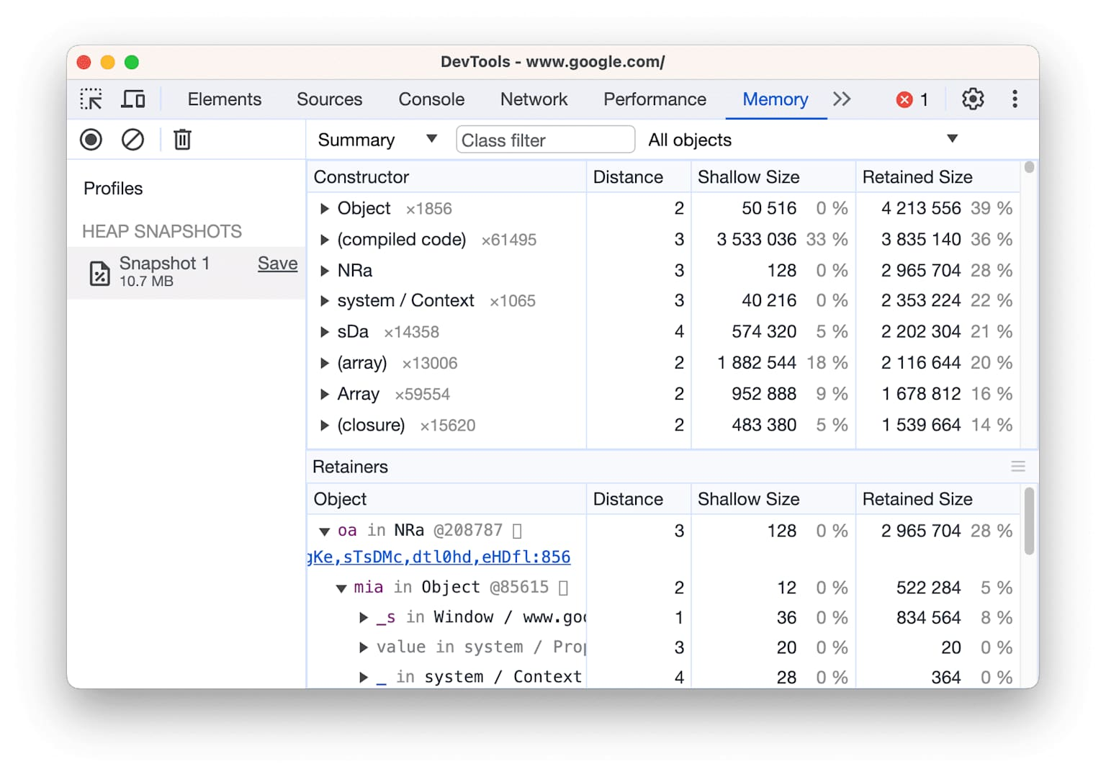
Features preview
https://developer.chrome.com/docs/devtools/overview
https://developer.chrome.com/docs/devtools/performance

Slide 10
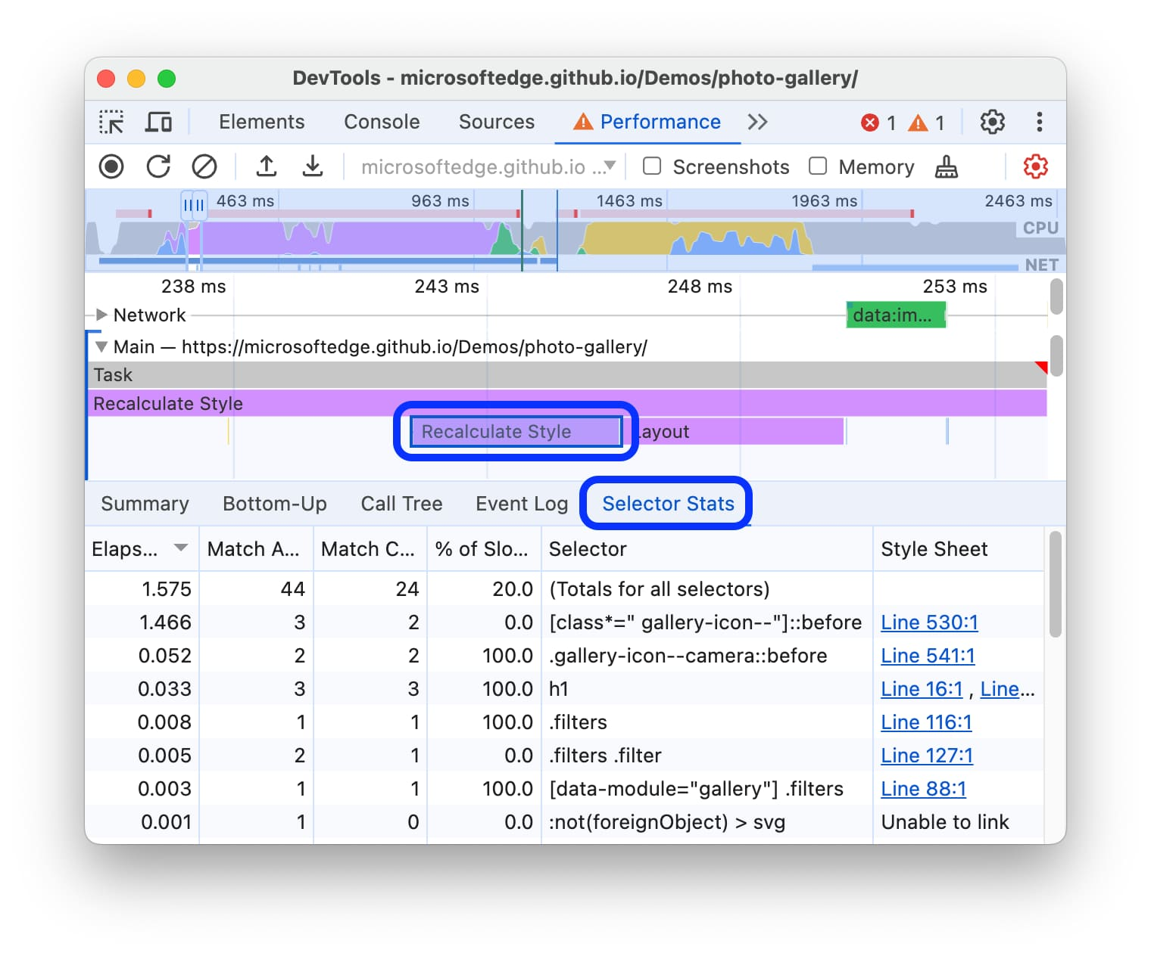
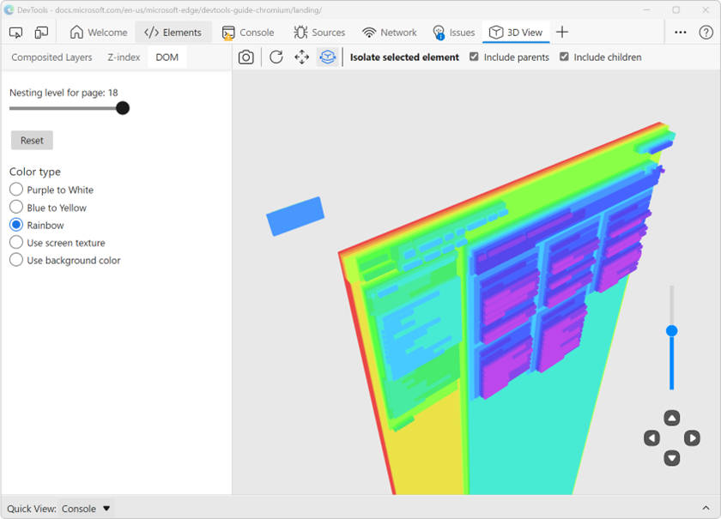
Features preview
https://developer.chrome.com/docs/devtools/performance/selector-stats
https://blogs.windows.com/msedgedev/2022/06/21/debug-the-web-in-3d-with-the-3d-view-tool/

Slide 11
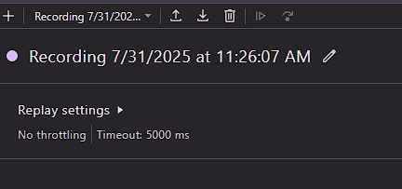
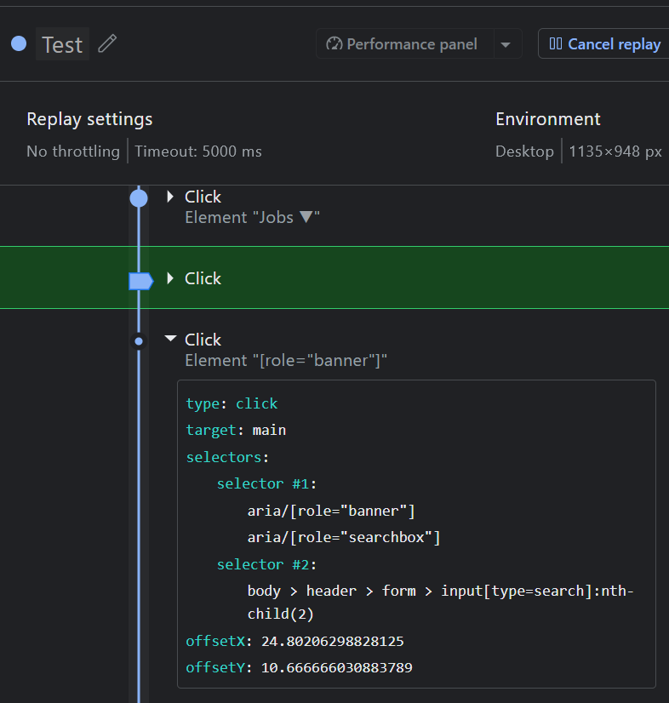
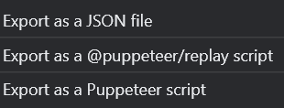
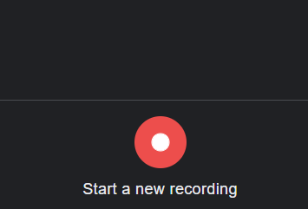
Automation - Recorder
Recorder is usefull tool to capture user behaviour and replay it.
We can also setup throttling and screen size.

Slide 12
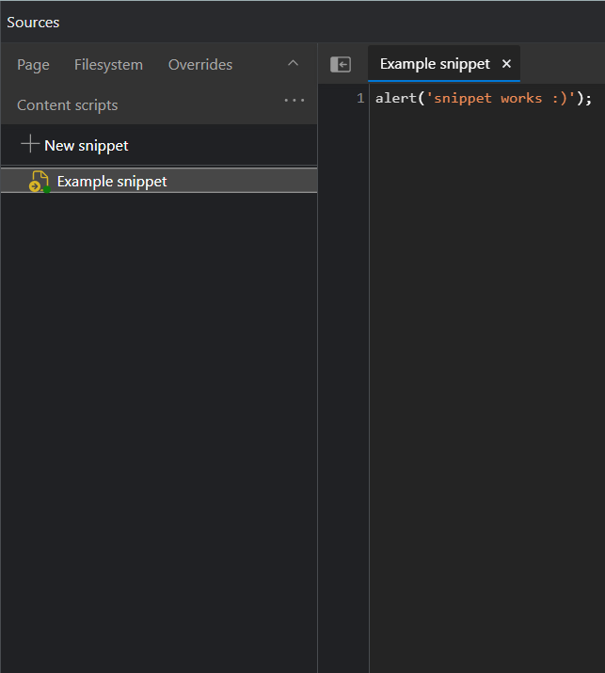
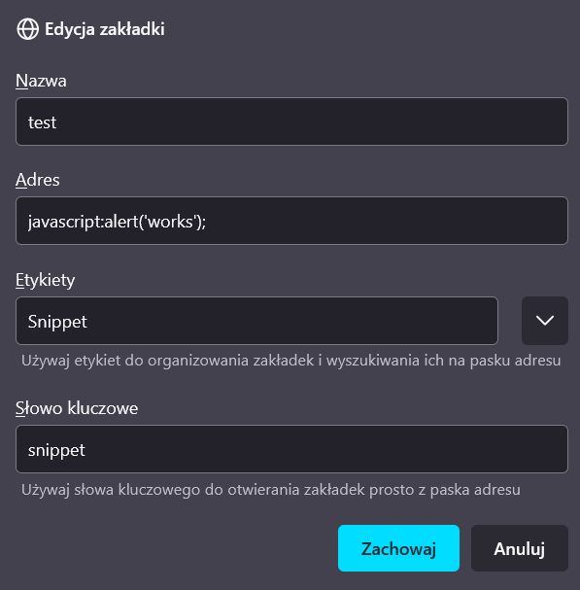
Automation - Snippets
Code snippets can currently be manually invoked in two different ways.
Declare snippet in source pane
(chromium-based browser)
Declare snippet in bookmark
(only firefox in allowed pages)

Slide 13
Console and debugging tricks
Awesome things you can perform inside your console, some debugging tricks

Slide 14
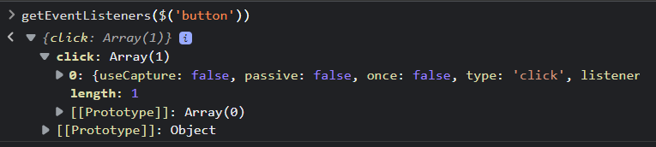
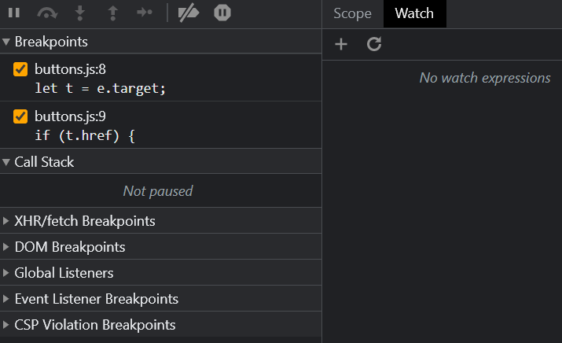
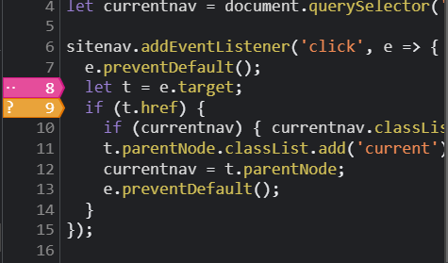
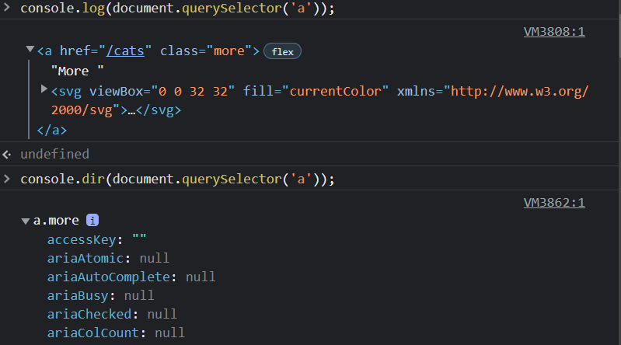
Debugging utils
Conditional line breakpoints
Logpoints instead of console logs
Live expressions
Watched variables
Monit events
Get event listeners
Pause debugger on event, xhr etc.
Remote debugging for instance Mobile
Live edit function while debugging

Slide 15
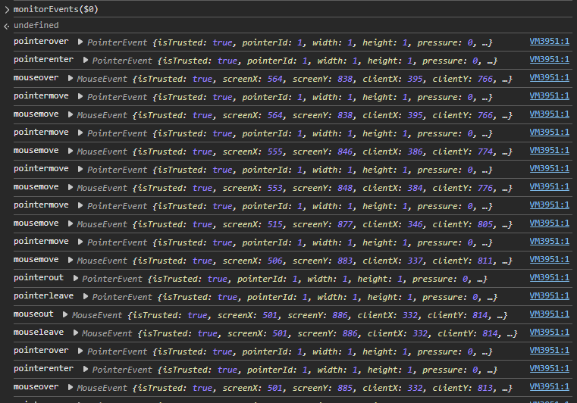
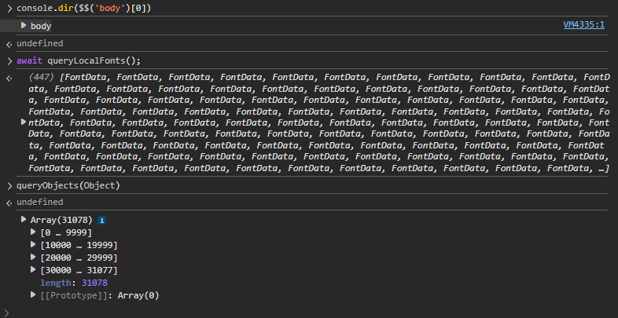
More debugging utils
debug() – creates a breakpoint before given function execution
copy() – copy into clipboard
Special selectors ($, $$, $x)
Printing – console methods, dirxml
inspect() – display element in the inspection panel
monitor/unmonitor – logs when function is called each time
monitorEvents/unmonitorEvents – log DOM events on object
queryObjects() – list objects created by specified constructor (class)
getEventsListener() – get registered event listeners of elements
profile(), profileEnd() - profiling

Slide 16
Chrome DevTools Protocol, WebDriver BIDI
Powerful ways to automate browser tasks, write e2e tests

Slide 17
Comparison between protocols
Protocol | Communication Type | Transport Protocol | Standardization | Browser Support | Additional notes
WebDriver Classic | Unidirectional (Request-Response) | JSON over HTTP/1.1 | W3C Standard, v2 (living standard) | Universal (all browsers) | Deprecated in Selenium 4
Chrome DevTools Protocol (CDP) | Bidirectional (Event-driven) | JSON-RPC, WebSocket | Chromium-specific | Chromium-based only | Each target requires separate session attachement
WebDriver BiDi | Bidirectional (Event-driven) | WebSocket/CDDL | W3C Standard (in development) | Chrome, Firefox, Edge (growing)

Slide 18
Features comparison
Feature | WebDriver Classic | Chrome DevTools Protocol (CDP) | WebDriver BiDi
Element Interaction | ✓ | ✓ | ✓
Page Navigation | ✓ | ✓ | ✓
Window/Tab Management | ✓ | ✓ | ✓
Screenshot Capture | ✓ | ✓ | ✓
Network Interception | ✗ | ✓ | ✓
Console Log Monitoring | ✗ | ✓ | ✓
JavaScript Execution | ✓ | ✓ | ✓
Cookie Management | ✓ | ✓ | ✓
File Downloads | ✓ | ✓ | ✓
Mobile Emulation | ✓ | ✓ | ✓
Performance Profiling | ✗ | ✓ | ✓
Memory Analysis | ✗ | ✓ | ✗
Timeline/Tracing | ✗ | ✓ | ✗
Security Headers | ✗ | ✓ | ✗
Service Worker Control | ✗ | ✓ | ✗
Geolocation Emulation | ✓ | ✓ | ✓
Device Emulation | ✓ | ✓ | ✓
Real-time DOM Events | ✗ | ✓ | ✓
Network Throttling | ✗ | ✓ | ✓
Coverage Analysis | ✗ | ✓ | ✗
JavaScript Debugging | ✗ | ✓ | ✓
CSS Styling Control | ✗ | ✓ | ✓
Authentication Headers | ✗ | ✓ | ✓
Request/Response Modification | ✗ | ✓ | ✓
Browser Context Isolation | ✗ | ✓ | ✓

Slide 19
Demo #1

Slide 20
AI in the web browser
Gemini Nano and Google API’s
AI DevTools
Loading custom model into a browser

Slide 21
How to enable Built-in AI Apis in Chrome
Sign up for the early preview program https://developer.chrome.com/docs/ai/join-epp
Install Chrome Canary to use latest features.
Enter chrome://chrome-urls/?host=chrome://on-device-internals/#internal-debug-pages and click “Disable internal debugging pages”
Relaunch browser
Enter chrome://flags/#prompt-api-for-gemini-nano and enable this feature flag
Model status can be checked on chrome://on-device-internals/

Slide 22
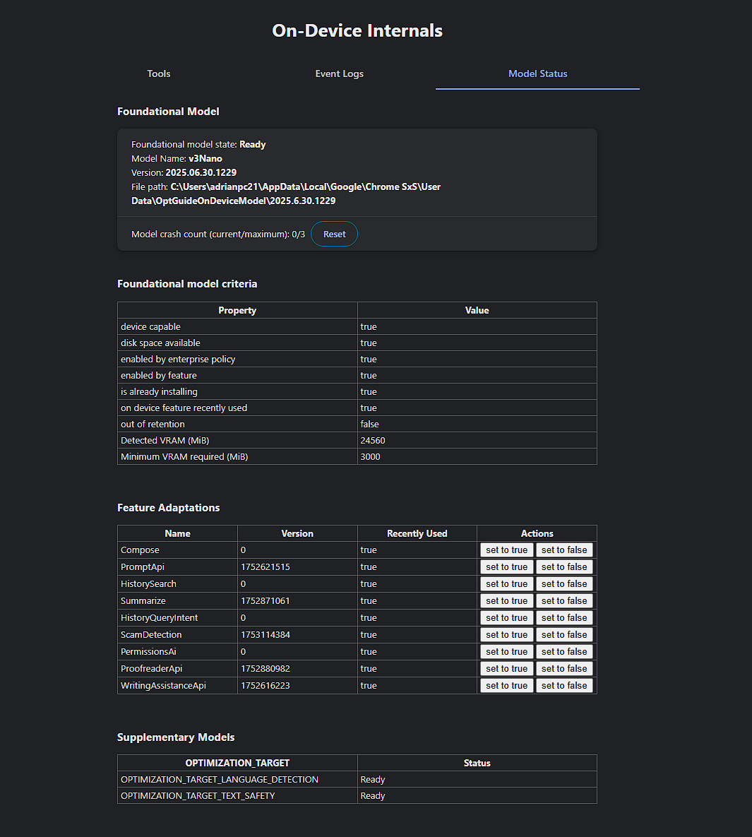
Model details

Slide 23
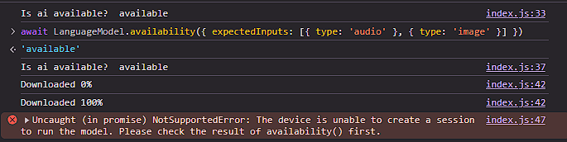
What you can do with Google Built-in Gemini (Nano) API?
Check availability of the model
Count tokens
Manage quota
Prompt with multimodality
Translator
Language detector
Writing
Rephrasing
Summarizing
https://developer.chrome.com/docs/ai/rewriter-api

Slide 24
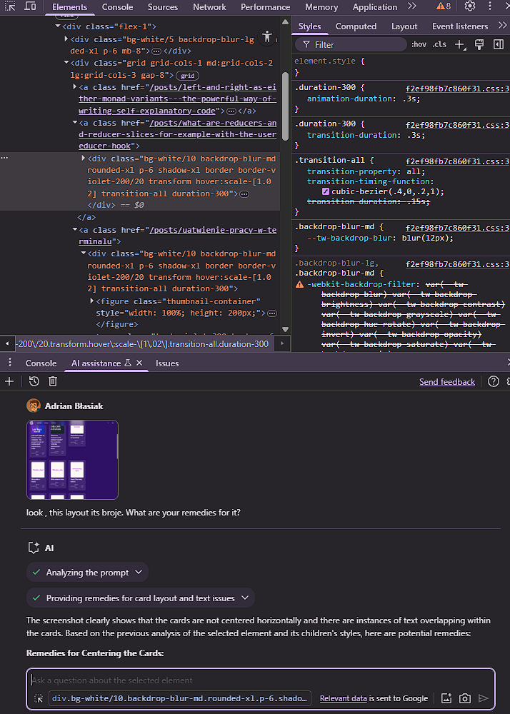
Element scoped advices
Prompt about your element
Capture screenshot with one button of visible area
Upload your own picture

Slide 25
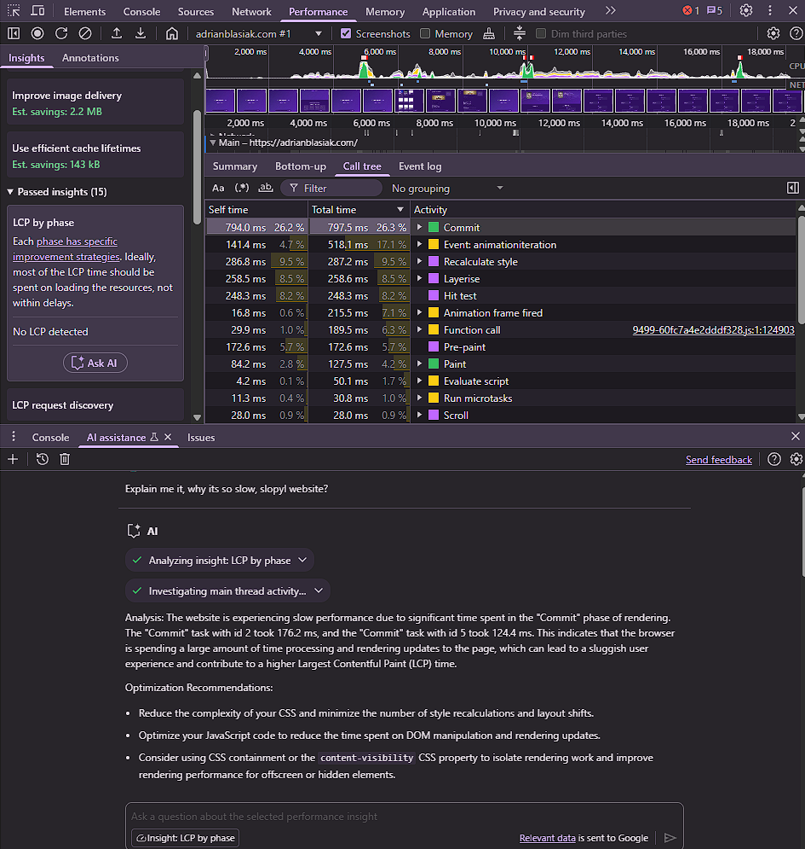
Performance Tips
* Ask AI about LSP bottleneck your’s website

Slide 26
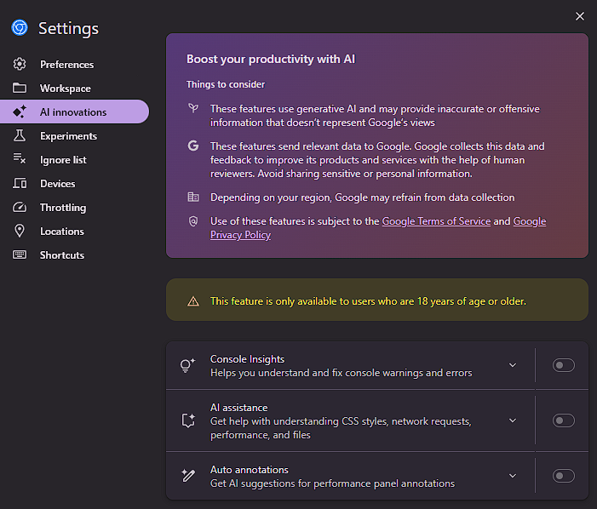
AI DevTools
✅ Eligibility Requirements:
You must be at least 18 years old
Your primary language must be set to English
You must be located in a supported region
For full details and instructions, visit the official documentation: 🔗

Slide 27
Communication between browser and your extension - BONUS

Slide 28
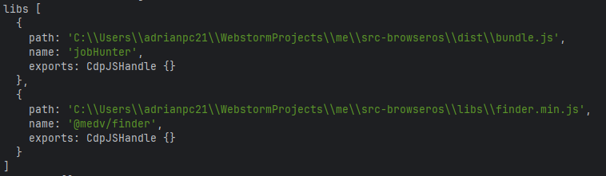
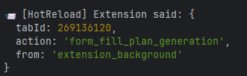
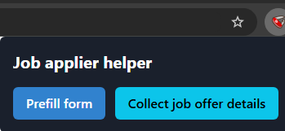
What we need? (via Connection Port)
Our extension loaded to a browser (for instance via puppeteer)
Get extension target and its ID
Open a connection port from the puppeteer
Listen for external connections from the extension, background script
To manage connection for each tab, store and track which one is closed and maintains a connection
Create a listener to catch all messages from the source

Slide 29
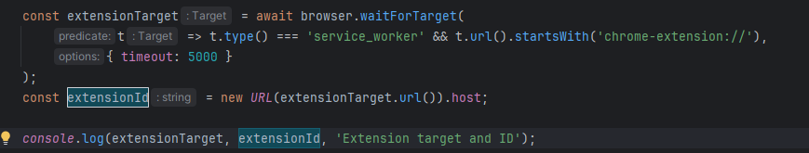
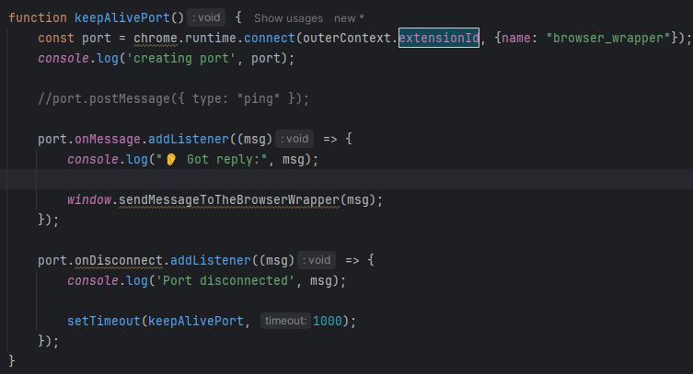
1
2

Slide 30
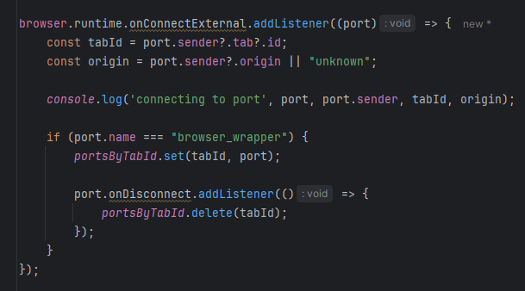
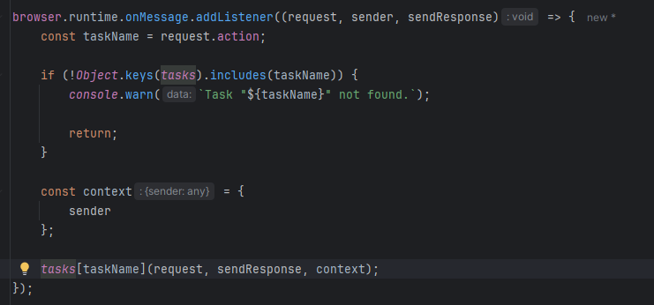
3
4

Slide 31
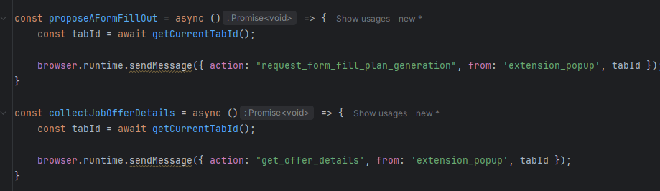
And you can now send your messages
Extension -> Puppeteer

Slide 32
Demo

Slide 33
Q&A

Slide 34
Thank you
THE END

